Slide 1
Welcome to Back to School Night
Grade 3
Phelps Luck Elementary School

Slide 2
Third Grade Team
ELA/Social Studies | Math/Science
Sarah McCann Meghan Bennett Jeanette Smith | Gretchen Gray Wendy Crockett Meghan Bennett
Para-Educator: Juli Hale

Slide 3
Our Daily Schedule
8:40-9:00 Arrival in Homeroom, Breakfast, Unpack
9:00-11:00 Academic Session I
10:55 Transition to Academic Session II
11:00-11:45 Related Arts (PE twice each week, music, art, media)
11:45-12:15 Spanish
12:15-1:00 Academic Session II
1:00-1:30 Lunch
1:30-2:00 Recess
2:00-3:15 Academic Session II
3:20 Dismissal

Slide 4
Dismissal
Students must have a note for any dismissal changes
Walkers and car riders leave with Mrs. Hale
Once walkers exit the building they are expected to walk home
Car riders must walk down the sidewalk with Mrs. Hale
For safety purposes, students cannot get in the car until the front of the loop

Slide 5
Our Daily Schedule
Academic Session I | Academic Session II
Your child will either have: Math and Science or ELA and Social Studies | Your child will either have: Math and Science or ELA and Social Studies All 3rd graders will receive 30 minutes of Spanish instruction during Academic Session II.

Slide 6
New for Third Grade
Report Card
Orchestra
PARCC
Multiplication and Division
Agenda Book
Binder and Supplies
Building Vocabulary

Slide 7
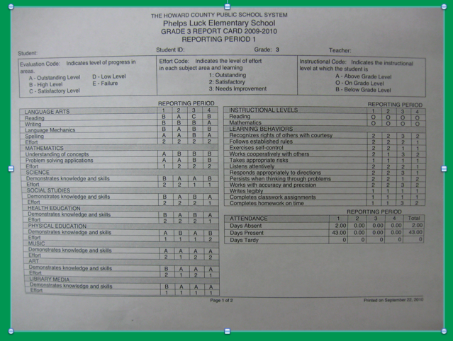

Slide 8
Grading Policy
Each grade is comprised of:
Classwork, Assessment Items and Homework
The majority of each grade is comprised of an average of the classwork tasks completed that quarter.

Slide 9
P.B.I.S.
Respect SELF
Respect OTHERS
Respect PROPERTY

Slide 10
PBIS
Positive Behavioral Interventions and Supports
We focus on POSITIVE behavior!
Fabulous Falcons
Monthly Celebrations
Quarterly Celebrations

Slide 11
PBIS in Grade 3
Color System
Green
Warning 1
Warning 2
Yellow = Stop and Think Form
Red = Office Referral
Communication in agenda book as necessary

Slide 12
Breakfast/Cafeteria
Breakfast is offered to our students everyday. Participation is voluntary and free.
Breakfast is offered in the classroom from 8:40-8:55.
Instruction starts at 9:00.
School lunch price is $2.75
All students have a lunch account (6-digit PIN)
Money can be added to this account online or cash can be brought in and given to Mrs. Hale (change is not available)

Slide 13
Communication
Agenda Books
Thursday Folders
Monthly Team Newsletters
3rd Grade Teacher Website (Shared Soon!)
School Website: http://ples.hcpss.org
Parent-Teacher Conferences (November, February)
Progress Reports and Report Cards

Slide 14
Special Activities and Field Trips
September -- PLES 5K (Saturday the 26th)
October -- Halloween Parade or Fall Festival In-School Field Trip -- Library Presentation
November -- Turkey Trot
December -- Gingerbread House Building
January -- Field Trip -- Monster Mini Golf Field Trip
February -- Valentine’s Day Party
March --
April --
May -- Field Day & Field Trip -- The Chesapeake Bay Environmental Center
June -- The Grammy’s & Field Trip -- Lake Elkhorn Nature Walk

Slide 15
PARCC
Partnership for Assessment of Readiness for College and Careers
•The PARCC assessment is administered in April
•The PARCC assessment measures student’s achievement in English Language (ELA) Literacy and Mathematics based on the learning standards contained in the Common Core State Standards.

Slide 16
MAP -- Measures of Academic Performance
•Designed to measure student growth.
•Determines instructional strengths and needs.
•MAP will be taken on the computer and adapts to each individual student.
•MAP will be administered approximately 3 times per year (October, January, May)
•MAP assessments are aligned to the national Common Core Standards for Mathematics and Reading that can be measured using multiple-choice items.

Slide 17
ELA Daily Schedule
Reading (75 minutes)
Building Vocabulary
Reading Standards
Writing/Social Studies (45 minutes)
Journal Writing
Writing Framework OR Social Studies

Slide 18
SMART GOALS
Specific: State exactly what you want to accomplish (Who, What, Where, Why)
S
Measurable: How will you show that you have met your goal? (How much? How many?)
M
Achievable: Is this a realistic goal? How can it be accomplished?
A
Relevant: How does this goal tie into your key responsibilities? How is it important both inside and outside of school?
R
Time-bound: When will this goal be accomplished by?
T

Slide 19
Writing Units
Narratives
Opinion Writing
Informational Writing (Written in Math / Science)

Slide 20
WORD STUDY
A Powerful New Approach
Phonics
Prefixes
Suffixes
Vocabulary
Greek & Latin Roots
Spelling

Slide 21
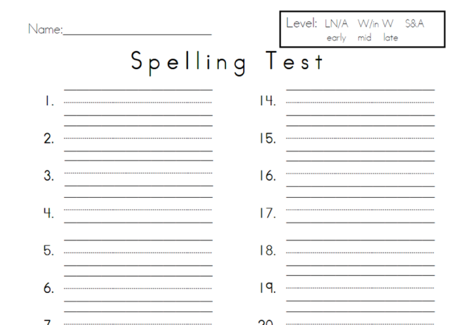
Word Study
THEN
Assigned word lists
Little or no connection to curricular areas or each other
The weekly assignment: “Find and write a definition for each word,” or “Use each word in a sentence”
A test came at the end of the week (rote memorization)

Slide 22
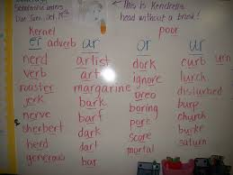
Word Study
NOW
Word lists are organized through meaningful roots or patterns
Expand and deepen word knowledge during content-area study
The weekly assignment:
“Meet the Root, Combine and
Create, Read and Reason,
Extend and Explore”
Applied spelling and language conventions tests

Slide 23
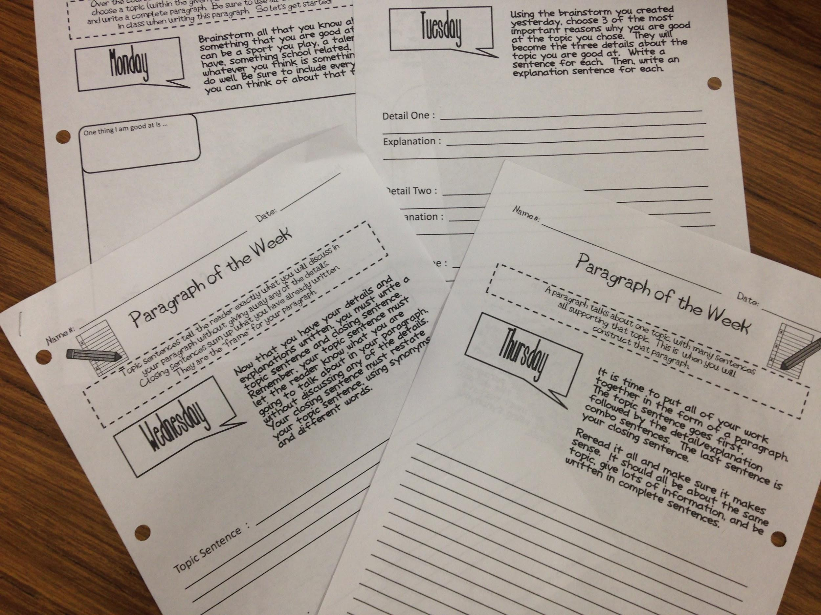
Writing Homework - P.O.W.
~ Brainstorm
~ Details & explanation
~ Topic & closing
sentences
~ Write the full
paragraph

Slide 25
How can you help at home?
Nightly reading – build stamina!
~ Pick books that fit
Writing practice – build stamina!
~ Praise & edit together
Ask questions!
~ Have your child respond with evidence or details

Slide 26
elaparentsupport.weebly.com
Notes:
Check this site

Slide 27
Thank you!
Thank you for coming tonight! We are looking forward to working with you and your children this year! If you ever have any questions or concerns, please do not hesitate to contact us!

