Slide 1
Welcome to Back to School Night
Grade 3
Phelps Luck Elementary School
Notes:
7:00-7:35 Connie and Michelle
7:35-8:05 Presentation 1 -- Academic Session 1
8:05-8:30 Presentation 2 -- Academic Session 2
Where will Math present? Gretchen’s Room
Where will ELA present? Jeanette’s Room
Gretchen

Slide 2
Third Grade Team
ELA/Social Studies | Math/Science
Sarah McCann *Melanie Mahoney Jeanette Smith | Gretchen Gray Meghan Bennett
Para-Educator: Juli Hale
Notes:
Gretchen

Slide 3
Our Daily Schedule
Academic Session I | Academic Session II
Your child will either have: Math and Science or ELA and Social Studies | Your child will either have: Math and Science or ELA and Social Studies All 3rd graders will receive 30 minutes of Spanish instruction during Academic Session II.
Notes:
Meghan

Slide 4
Our Daily Schedule
8:40-9:00 Arrival in Homeroom, Breakfast, Unpack
9:00-10:55 Academic Session I
10:55 Transition to Academic Session II
11:00-11:45 Related Arts (PE twice each week, music, art, media)
11:45-12:15 Spanish
12:15-1:15 Academic Session II
1:15-1:45 Lunch
1:45-2:15 Recess
2:15-3:15 Academic Session II
3:20 Dismissal
Notes:
Meghan

Slide 5
New for Third Grade
Report Card
Orchestra
PARCC
Multiplication and Division
Agenda Book
Binder and Supplies
Notes:
Have sample agenda book ready
Have sample binder and pencil bag ready
Gretchen

Slide 6
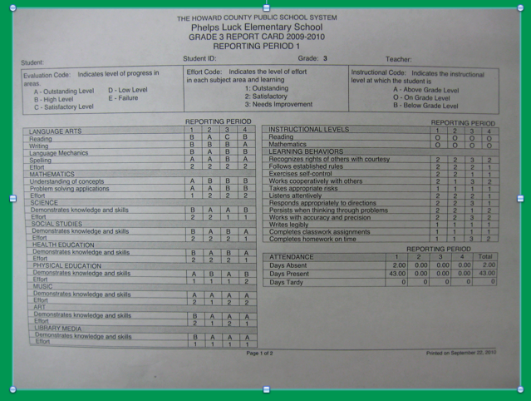
Notes:
Have a copy of the report card for families
Gretchen (Meg passes out)

Slide 7
Grading Policy
Each grade is comprised of:
Classwork, Assessment Items and Homework Completion
The majority of each grade is comprised of an average of the classwork tasks completed that quarter.
Notes:
Meghan

Slide 8
P.B.I.S. at PLES
Respect SELF Respect OTHERS Respect PROPERTY
•PBIS focuses on acknowledging students for consistent positive behaviors.
•Staff and students build positive relationships.
•Routines and language are consistent throughout the school.
Notes:
Meghan

Slide 9
Let’s Create an Amazing Classroom Community!
We’ll build a positive culture by encouraging skills like “Helping others” and “Perseverance”.
We want all parents engaged in our classroom, seeing what we’re learning every day
Notes:
Gretchen

Slide 10
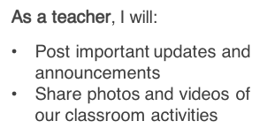
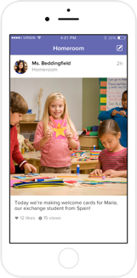
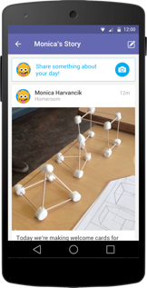
How we’ll use Class DoJo...
Notes:
Gretchen

Slide 11
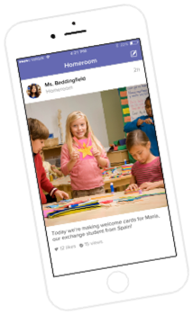
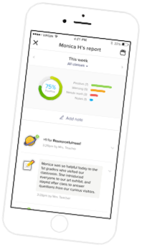
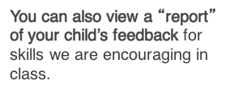
What do parents see?
Notes:
Gretchen

Slide 12
DoJo Points
• DoJo points are incentives that are earned throughout the school day.
•When a student demonstrates the expected behaviors, (Respecting self, others, and property) they receive DoJo points.
DoJo points are redeemed for incentives in the classroom, team, or school-wide.
Notes:
Meghan

Slide 13
PBIS -- Incentives
Team-wide incentives
Team-wide monthly incentives include many of the following activities:
•Themed Relay Races
School-wide incentives
At the end of each quarter, all students will participate in a school-wide incentive.
Some incentive ideas are:
•DROP EVERYTHING AND DANCE!
•Fine Dining Friday
•Gift card raffles
Notes:
Meghan

Slide 14
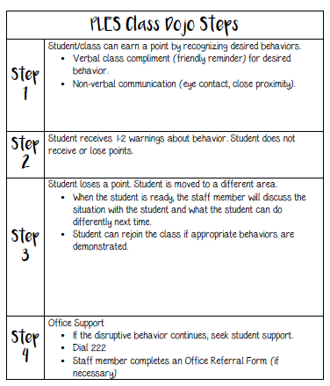
Notes:
Gretchen

Slide 15
How can you support PBIS at home?
Talk with your child about what it means to respect self, others and property at home.
Focus on the positive things that your child does at home and talk about why these behaviors are important to you.
Assist teachers in the classroom with management of the PBIS program if needed.
Review the PBIS parent flyer that will be going home soon.
If you notice your child lost a point, discuss what caused it to happen
Notes:
Gretchen

Slide 16
Breakfast/Cafeteria
Breakfast is offered to our students everyday. Participation is voluntary and free.
Breakfast is offered in the classroom from 8:40-8:55.
Instruction starts at 9:00.
School lunch price is $2.75
All students have a lunch account (6-digit PIN)
Money can be added to this account online or cash can be brought in and given to Mrs. Hale (change is not available)
Notes:
Meghan

Slide 17
Communication
Agenda Books
Thursday Folders
Dojo!
3rd Grade Teacher Website -- CANVAS
3rd Grade Team Website -- CANVAS
School Website: http://ples.hcpss.org
Parent-Teacher Conferences (November, March)
Progress Reports and Report Cards
Notes:
Meghan

Slide 18
Dismissal
Students must have a note for any dismissal changes
Walkers and car riders leave with Mrs. Hale
Once walkers exit the building they are expected to walk home
Car riders must walk down the sidewalk with Mrs. Hale
For safety purposes, students must notify Mrs. Hale prior to getting in a vehicle
Notes:
Meghan

Slide 19
Special Activities and Field Trips
September --
October -- PLES 5K
November -- Turkey Trot -- Conferences
December -- Gingerbread House Building
January -- Field Trip, Monster Mini Golf Field Trip
February --
March -- Field Trip, Theater -- Conferences
April --
May --
June -- Field Day -- The Grammy’s & Field Trip -- Lake Elkhorn Nature Walk
Notes:
Meghan

Slide 20
What does math look like each day?
•75 minutes daily
•Begins with a high-quality number routine
•Standards based instruction: high quality tasks, variety of representations, purposeful questions, and student discourse
•Closure everyday
Notes:
Gretchen

Slide 21
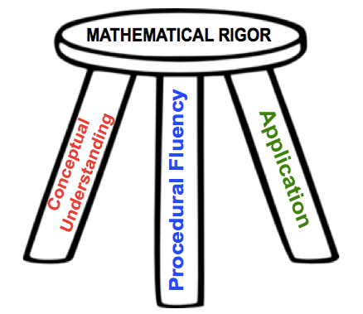
Balanced Instruction
Notes:
Gretchen

Slide 22
What will Our Students Learn?
Place Value
Solidify Addition and Subtraction
3rd Grade Math -- Standard Algorithm not Required
4th Grade Math -- Standard Algorithm Required
Learn Multiplication and Division
Fractions
Elapsed Time
Area and Perimeter
Attributes of Shapes
Notes:
Meghan

Slide 23
Basic Facts
Students will learn ALL basic facts for multiplication and division.
September/October: 2’s, 5’s, 10’s
November/December: 0’s, 1’s, 3’s
January/February: Review of what we’ve learned
March/April: 6’s, 9’s
May/June: 4’s, 7’s, 8’s
Once students learn all multiplication and division facts fluently, they can earn a Fast Fact Falcon shirt!
Join us on Wednesday, October 19th from 6:30 -- 8:00 for our Basic Fact Night!
Notes:
Meghan

Slide 24
Math Homework
The purpose of homework at this age is to practice already learned skills. Also, the “habit”.
Your child will receive math homework
Monday -- Thursday
Two nights each week: CC Review Homework
Two nights each week: Current Skill Practice
Selected skill practice homeworks are intended to be completed independently.
Notes:
Gretchen

Slide 25
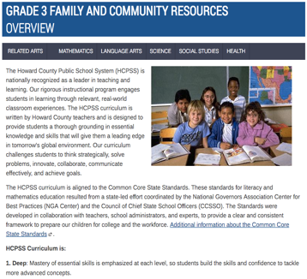
Family & Community Information on Canvas
Notes:
Gretchen
Family and community resources are now located in the same place for all different content areas by grade level. So when you want to know what your 3rd grader will be learning and how to help them in reading, math, social studies, etc. you will only need to navigate from one page.
https://hcpss.instructure.com/courses/34429#

Slide 26
Next Generation Science Standards
Quarter 1: Weather and Climate
Quarter 2: Forces and Interactions
Quarter 3: Interdependent Relationships in Ecosystems: Plant and Animal Survival
Quarter 4: Inheritance and Variation of Traits: Life Cycles and Traits
Each quarter ends with a culminating activity. We will be looking for volunteers to help faciliate these.
Notes:
Meghan

Slide 27
Questions?

Slide 28
Thank you for coming tonight! We are looking forward to working with you and your children this year! If you ever have any questions or concerns, please do not hesitate to contact us!
Your final session is to inform you about ELA in Mrs. Smith’s room next to art.

Slide 29
ELA Daily Schedule
Reading (75 minutes)
Readers workshop and small group instruction
Writing/Social Studies (45 minutes)
Writing stories and opinion pieces
Notes:
Add

Slide 30
Social Studies
Quarter 1: Changing Communities
Quarter 2: Mapping Our World
Quarter 3: Money Matters
Quarter 4: Project Citizen
Notes:
Quarter 1 focuses on
Life in historic Ellicott City
Changes in communication and transportation
Changes in technology
Impact of global trade
Impact of natural disasters
Quarter 2
World map
U.S. Regions
Geography and people
Immigration
Sharing and borrowing culture
Quarter 3 focus
Decision making
Supply and demand
Saving money
Borrowing money
Creating a budget
Quarter 4 focus
Civic virtue and democratic principles
Taxes
Community goods & services
Leaders in community
Community problem solving

Slide 31
ELA Homework
~ Monday and Wednesday: students will pick a writing prompt from the choice board and they will write.
~ Tuesday and Thursday: students will respond to what they have been reading at home.
~ Monday-Thursday: students will read at least 20 minutes a night.

Slide 33
How can you help at home?
Nightly reading – build stamina!
~ Pick books that fit
Writing practice – build stamina!
~ Praise & Ask questions
~ Have your child respond with evidence or details

Slide 34
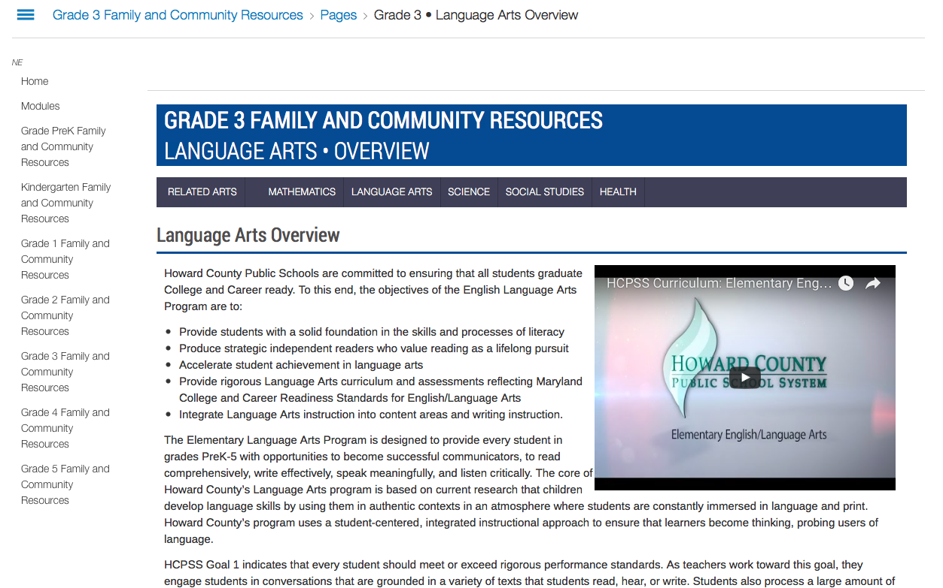
https://hcpss.instructure.com/courses/34429/pages/grade-3-star-language-arts-overview
Notes:
When you click on the language arts button there is an option for an overview, what your child will learn, how to support your child, and additional resources.

Slide 35
Thank you!
Thank you for coming tonight! We are looking forward to working with you and your children this year! If you ever have any questions or concerns, please do not hesitate to contact us!

Slide 36
Questions...

