Slide 1
Phelps Luck Kindergarten
Back to School Night
2017-2018

Slide 2
Our Administrators
Michelle Leader, Principal
Connie Fowlkes, Assistant Principal
Jackie Cholewczynski, PTA President

Slide 3
PLES Parent Teacher Association (PTA)
The PTA is a group of parents and teachers who volunteer their time to provide academic, social, and cultural enrichment to each student at PLES throughout the school year.
Executive Committee:
Jackie Cholewczynski – President
Steve Tabak – Vice President 1 (Financial Oversight)
Amy Shupps – Vice President 2 (Fundraising)
Michele McGee-Guthrie – Vice President 3 (Teacher Liaison)
Ann Wacha – Treasurer
Kelly Frank – Secretary

Slide 4
Membership Q&A
How much is it to be a member of the PTA?
$10 per person, per year
What does membership mean?
Membership means you are able to vote on PTA matters at our monthly meetings
When are the PTA meetings?
First Wednesday of every month (except September and January) at 7pm in the Media Center
Are meetings mandatory?
NO!
Do I have to be a member to volunteer at PTA events?
NO!
Do I have to volunteer a certain number of times as a member?
NO! We will take all the time you can give. We recognize that people work and so do most of us!
Who attends the PTA meetings?
Parents, grandparents, relatives and best of all, our Principal Mrs. Leader and Assistant Principal Mrs. Fowlkes

Slide 5
What does the PTA do?
Fundraising
Dine Out Nights, Fall/Spring Fundraisers, Box Tops for Education, Spirit Wear
Enrichment
Book Fairs, Science Fair
Wellness
Family 5K And Family Fun Run
Social Activities
Paint Nights, Dances, Movie Nights, Bingo Night
Staff Appreciation
Back to School Teacher Breakfast, Conference Dinners, Teacher Appreciation Week
Community Outreach
Mobile Food Pantry
Funding
Field Trips, Cultural Assemblies. Simulated Congressional Hearings
Publications
Yearbook, School Directory

Slide 6
What We Need from You
Membership!
Volunteers!
Donations!
Ideas!
Participation!
Current Committee Chair Opportunities:
3rd Grade Daddy/Daughter & Mommy/Son Dance (2/15)
Spring Paint Night (4/19)
PTA Bulletin Board (year round)

Slide 7
Title I
School-wide enhanced programs and services
Family involvement
Notes:
**This slide for use only by Title I schools.
Title I Services – Overview
[Name of School] is one of 12 Title I schools in Howard County. Title I is a federally funded program designed to ensure all children have an opportunity to access a high quality education.
Title I federal funding is used to support and enhance the school program, and provide additional academic support, for every child in the school.
The goal of this program is to close the achievement gap for all students. While there are two types of Title I programs, Targeted Assistance and School-wide, all Howard County Title I schools including [school name] are school-wide programs.
Our program allows all students to be eligible for additional academic support and the funds are used to support and enhance the overall school program.
The school and Title I program value parent perspective. We appreciate any suggestions, comments or questions from our families.
Family Programs will be offered throughout the school year.
A variety of Title I resources are available (insert location available – for example: our School-Parent compact can be found in the Friday Folder) and on our school website.
Important Documents:
Please visit the table located __________________. Staff members at the table will share with you several Title I documents and answer your questions.
School-Parent Compact/ Parent Involvement Plan
Countywide policy and plan
Policy 10000, Parent, Family, and Community Involvement
These documents are also available on our school website.
During the school year, we would welcome any feedback related to our Title I Schoolwide programming.
Title I schools in Howard County:
Bollman Bridge
Bryant Woods
Cradlerock
Deep Run
Guilford
Laurel Woods
Longfellow
Phelps Luck
Running Brook
Stevens Forest
Swansfield
Talbott Springs

Slide 8
School News and Information
Email – School Messages
Print
Social Media @hcpss_ples
Video
In Person
Notes:
School Communications – OVERVIEW
Engaging parents and families as partners in education is one of the highest priorities of our school system and school. We use several communications tools to keep parents informed of what’s happening in the school and provide the information you need to make informed decisions regarding your child’s education. I’ll describe each of these in a moment [covered on following slides].
Often – personal communications are best.
Most important is that you feel comfortable reaching out to teachers and administrators whenever you have a concern or question. We’re happy to meet with parents or have you visit the classroom. Please call the school office with questions or to set up a convenient time. We also value parent involvement in school activities.
Feel free to contact any teacher or administrator via Email, or make an appointment to meet to discuss your concerns.

Slide 9
Emergency Cards/Essential Documents
Emergency Procedure Forms include: early closing and photograph permission
Complete online using HCPSS Connect. (www.hcpss.org/connect)
Immunizations and medical forms

Slide 10
Our Fabulous Kindergarten Team
Teachers: Helen Harlin,Helen Stovall, Megan Hoke, Michele Dorsey, Margaret Palmieri (ITL)
Intern: Sonya Beall
Spec. Ed Support: Maureen Gilbert
Para Educators: Carol Wilson, Allison Scharf
ESOL Support: Jen Lebro
Math Support: Isaac Clark

Slide 11
Daily Schedule
8:40 First Bell Breakfast Begins
8:55 Late Bell/Announcements Begin
9:00 Announcements/ Breakfast End
9:00-10:30 Writing/Reading
10:30 Recess
11:00 Math
12:15 Lunch
12:45 Content/Centers
1:15 Spanish
1:45 Related Arts (Art, Media, PE, Music)
2:30 Centers/Content
3:00 Clean-up/Pack-up
3:15 Dismissal

Slide 12
Breakfast Program
Free breakfast offered daily to all students
Participation is optional
Students need to arrive on time so they can take advantage of the program
Includes milk and prepackaged items such as cereal, bagels, pancakes, French toast and egg sandwiches.

Slide 13
Lunch
Students may bring lunch from home or purchase lunch for $2.75
Kindergarten has their own lunch period in the cafeteria
We have an “allergen free” table
Menus can be found on www.hcpss.org
Please send money in a bag or envelope labeled with your child’s name
www.myschoolbucks.com to set up account for automatic payments
Lunch Room volunteers

Slide 14
Lunch
Label your child’s lunch box or bag with his/her name.
Do not pack too much food! Kids will be busy talking with friends and may not eat as much as at home.
We suggest a half sandwich, piece of fruit, pretzels or popcorn and drink.
Any prepackaged food, please snip the corner of the package to make it easier for kids to open items independently.

Slide 15
Recess
30 minutes each day
Dress child appropriately for the weather and play
Children will go outside as long as the temperature is above 20 degrees including wind chill
Children are expected to respond to the whistle by coming to line immediately (safety precaution)

Slide 16
Birthday Celebrations
Non-food items only such as stickers, playdough, pencils
Contact your child’s teacher before sending items
Sign up on the Class Email list to contact families about parties at home. Please do not send invitations to school.

Slide 17
Field Trips
East Columbia branch Library—no cost! (Feb)
Arts on Stage at Goucher College (March 15)
Clark’s Elioak Farm ( April 20)

Slide 18
Transportation
A transportation form is in your child’s classroom today. It is ESSENTIAL to have this dismissal information before school begins on Tuesday for the safety of each child.
To avoid confusion, we URGE you to follow your child’s regular transportation procedure on the first day of school so your child can learn his/her dismissal routine.
We will always follow your child’s normal transportation routine unless we have a note specifying a change. For last minute changes PLEASE CALL THE FRONT OFFICE prior to 3:00.
When picking-up a child from school, all adults must present a photo ID and must be listed on the child’s emergency card (including parents/guardians). This is HCPSS policy and is for the safety of your child.

Slide 19
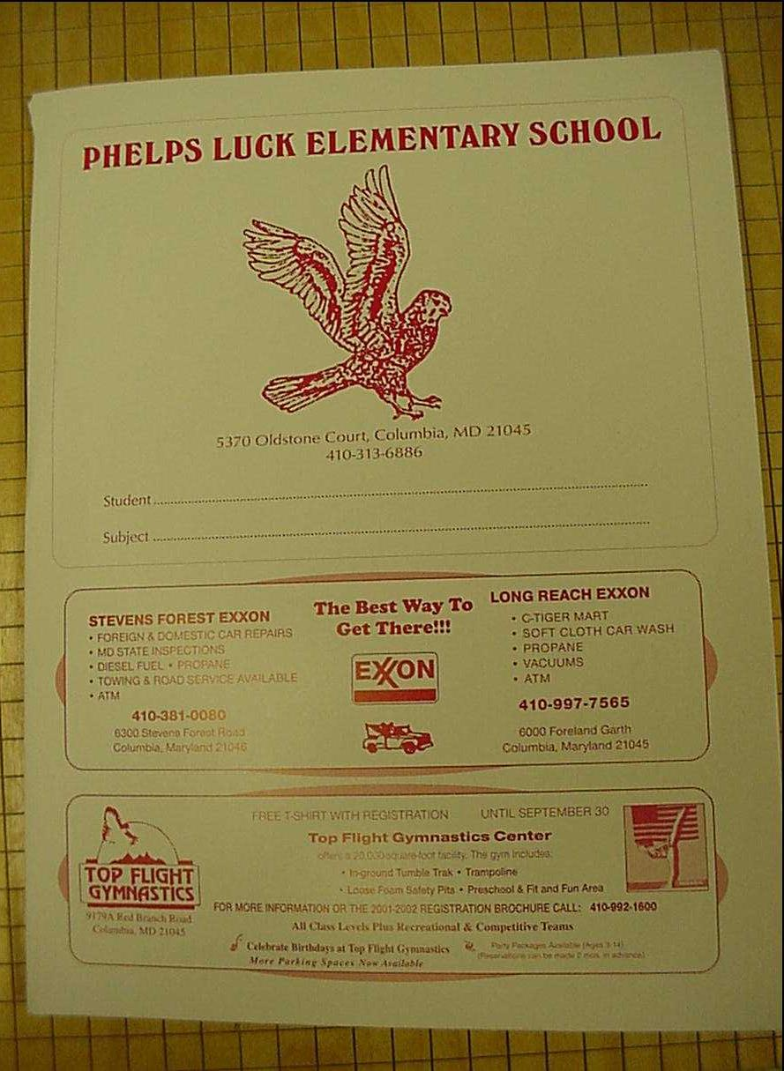
Communication
Phelps Luck Folders
Folders should come to school EVERY DAY.
Please check folders at home EVERY DAY to remove student work and check for important papers.
Use the folder to send money to school,
absentee notes and other important papers.

Slide 20
Class Dojo
We’ll build a positive culture by encouraging skills like “Helping others” and “Perseverance”.
We want all parents engaged in our classroom, seeing what we’re learning every day!

Slide 21
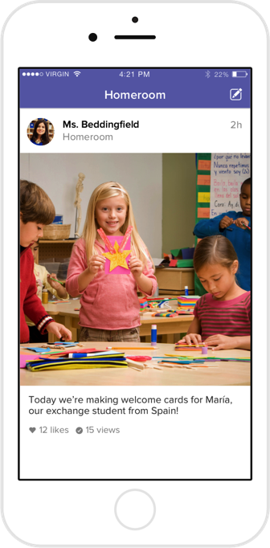
Using Class Dojo
As a teacher, I will:
Post important updates and announcements
Share photos and videos of our classroom activities
Send individual messages to parents
Messages you send are only seen by the classroom teacher

Slide 22
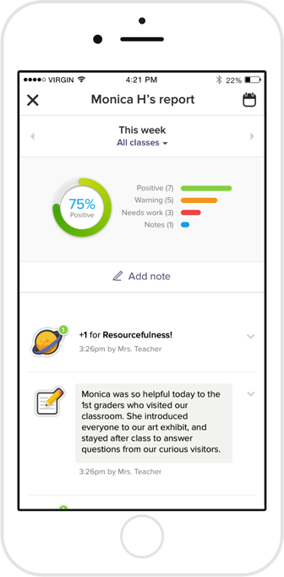
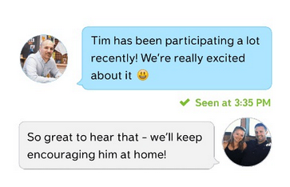
What Parents Will See
You’ll see the “Story” of our classroom: photos and videos of big moments and important updates

Slide 23
Volunteers
We do enjoy having volunteers in our classrooms!
Volunteers will work with small groups to do Art projects, review skills, play games or assist students with work completion.
You can sign up today to volunteer on a weekly, monthly or ”when my schedule allows” basis (with 24 hours notice).

Slide 24
Parent Conferences
Monday and Tuesday, November 20-21st 1:00-8:00 PM
You can contact your child’s teacher throughout the year if you ever want to have a conference.
Keep in touch with your child’s teacher through email, Class Dojo, phone calls or notes in your child’s folder.

Slide 25
What will your child learn this year?
Language Arts
Reading, Writing, Speaking, Listening
Math
Counting and Cardinality
Operations and Algebraic Thinking
Geometry
Numbers and Operations in Base Ten
Measurement and Data

Slide 26
Math
Common Core Math Standards will be followed. Parents will receive quarterly updates about what students are learning and how to help at home.
Students are grouped by ability within each classroom based on Math Assessments, classroom observations and data collection.
Students may end up switching to another classroom just for Math if we feel their needs would be better served in another group. Parents will always be notified of any changes.

Slide 27
Math
Children will use math manipulatives including blocks, dice, buttons, counters, connecting cubes, etc.
Math rotations will include partner games, small group instruction with the teacher and technology (iPads/laptops).
Dreambox is a Math program that will be used school wide. You will also receive information about how to log on so your child can play at home.

Slide 28
Reading
Groups formed based on student’s current benchmark level and other data.
Groups are flexible and changing.
Formative and summative data used to inform our teaching.
Students will work at independent centers while the teacher meets with small groups daily. (Word Work, Listening to Reading, crafts)
Reading levels include Pre-Emergent, Emergent, Early, Transitional and Fluent. Shared during conferences, on report cards.
We want Kindergarten students to read level D books by the end of the year to be well prepared for First Grade.

Slide 29
Writing
We study 3 genres-Opinion, Informative and Narrative writing.
The first quarter will be spent working on building a community of authors in our classrooms through drawing, shared writing, interactive writing, and group discussions.
We will also work on correct formation of letters.

Slide 30
Content Units
Social Studies
Unit 1 Home and School (rules and routines)
Unit 2 It’s a Busy World (Community Helpers, Goods and Services)
Unit 3 My Country ’Tis of Thee (American Symbols and Famous Americans)
Unit 4 Maps and Me (Maps, directions, symbols)
Science
Unit 1 What is a Scientist/Engineer?
Unit 2 Weather and Climate
Unit 3 Pushes and Pulls---Save toilet paper rolls!!!
Unit 4 Ecosystems
Health
Social and Emotional, Nutrition and Fitness, Safety, Injury and Illness Prevention
https://hcpss.instructure.com/courses/34447 for more curriculum resources

Slide 31
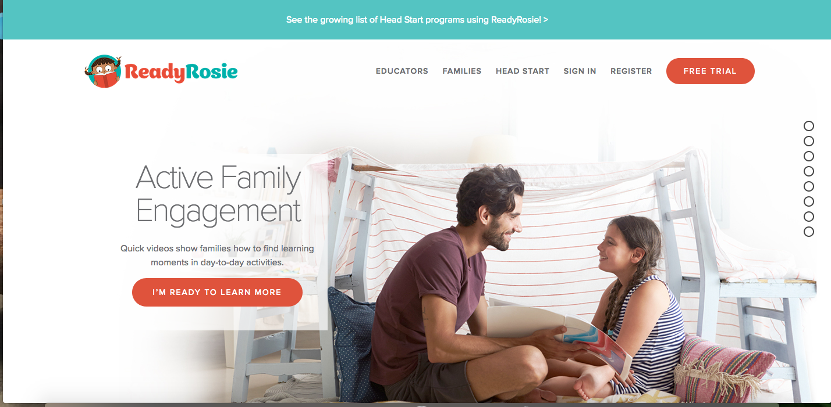
Ready Rosie

Slide 32
Related Arts Classes
Art: will do painting and clay so dress appropriately.
Media: students will check out books weekly. Must be returned to check out a new book.
Music: will learn songs, rhythm, instruments, patterns.
PE: students must wear appropriate shoes to participate.

Slide 33
First Day of School
Students may enter when the bell rings at 8:40.
All Kindergarten students will meet in the cafeteria on the first 2 days of school (Tuesday and Wednesday)
The rest of the week, students will walk down to the classrooms by themselves. Staff will support students in the hallway.
Students will be learning lots of routines and will be very tired and hungry when they get home!
Talk with your child about the school day and give time to relax in the evening.

Slide 34
Let’s go see the classrooms!
While in the classroom, please check that your child’s name is spelled correctly. If your child has a nickname that they prefer please let us know so we can make corrections.
Please fill out the transportation paper so we know where each child will be going at the end of the day.
If you have brought your child’s school supplies you can drop them off in the classroom.
OPEN HOUSE TOMORROW 1:30 BRING YOUR CHILD TO MEET THE TEACHER AND SEE THE CLASSROOM

Slide 35
THANK YOU FOR COMING!
We are looking forward to a great year of learning together!

