Slide 1
Welcome to Back to School Night
Grade 3
Phelps Luck Elementary School

Slide 2
Third Grade Team
ELA/Social Studies | Math/Science
Sarah McCann Meghan Bennett Jeanette Smith | Gretchen Gray Wendy Crockett Meghan Bennett
Para-Educator: Juli Hale

Slide 3
Our Daily Schedule
8:40-9:00 Arrival in Homeroom, Breakfast, Unpack
9:00-11:00 Academic Session I
10:55 Transition to Academic Session II
11:00-11:45 Related Arts (PE twice each week, music, art, media)
11:45-12:15 Spanish
12:15-1:00 Academic Session II
1:00-1:30 Lunch
1:30-2:00 Recess
2:00-3:15 Academic Session II
3:20 Dismissal

Slide 4
Dismissal
Students must have a note for any dismissal changes
Walkers and car riders leave with Mrs. Hale
Once walkers exit the building they are expected to walk home
Car riders must walk down the sidewalk with Mrs. Hale
For safety purposes, students cannot get in the car until the front of the loop

Slide 5
Our Daily Schedule
Academic Session I | Academic Session II
Your child will either have: Math and Science or ELA and Social Studies | Your child will either have: Math and Science or ELA and Social Studies All 3rd graders will receive 30 minutes of Spanish instruction during Academic Session II.

Slide 6
New for Third Grade
Report Card
Orchestra
PARCC
Multiplication and Division
Agenda Book
Binder and Supplies
Building Vocabulary
Notes:
Have sample agenda book ready
Have sample binder and pencil bag ready

Slide 7
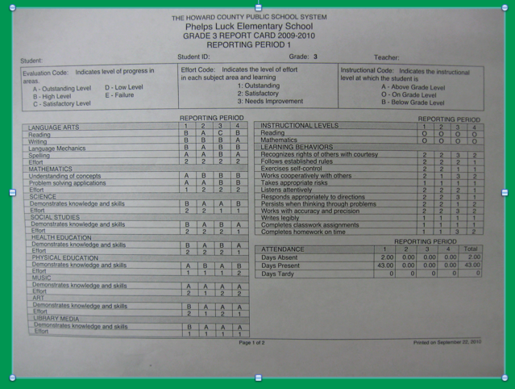

Slide 8
Grading Policy
Each grade is comprised of:
Classwork, Assessment Items and Homework
The majority of each grade is comprised of an average of the classwork tasks completed that quarter.

Slide 9
P.B.I.S.
Respect SELF Respect OTHERS Respect PROPERTY
•PBIS focuses on acknowledging students for consistent positive behaviors.
•Staff and students build positive relationships.
•Routines and language are consistent throughout the school.

Slide 10
PBIS -- Incentives
Fabulous Falcons are incentives that are earned throughout the school day.
When a student demonstrates the expected behaviors they receive a Falcon. They are redeemed for incentives in the classroom, team, or school-wide.
Classroom incentives examples:
 Sit at the teacher’s desk
 Use a special pen to do class work
 Extra computer time
 Read a story to the class
 Sit in a special chair
 Special classroom job
 Lunch bunch
Notes:
Bring Sample Fabulous Falcons

Slide 11
PBIS -- Incentives
Team-wide incentives
Team-wide monthly incentives include many of the following activities:
•Extra recess time
•Team-wide art project
•Movie
•Stations
•Dance party
School-wide incentives
At the end of each quarter, all students will participate in a school-wide incentive.
Some incentive ideas are:
•DROP EVERYTHING AND DANCE!
•Fine Dining Friday
•Gift card raffles

Slide 12
PBIS in Grade 3
Color System
Green
Warning 1
Warning 2
Yellow = Stop and Think Form
Red = Office Referral
Communication in agenda book as necessary
Notes:
Have sample classroom chart
Have Stop and Think Form with Yellow Half Sheet

Slide 13
How can you support PBIS at home?
•Talk with your child about what it means to respect self, others and property at home.
•Focus on the positive things that your child does at home and talk about why these behaviors are important to you.
•Assist teachers in the classroom with management of the PBIS program if needed.
•Review the PBIS parent flyer that went home in the Thursday folder with your child.

Slide 14
Breakfast/Cafeteria
Breakfast is offered to our students everyday. Participation is voluntary and free.
Breakfast is offered in the classroom from 8:40-8:55.
Instruction starts at 9:00.
School lunch price is $2.75
All students have a lunch account (6-digit PIN)
Money can be added to this account online or cash can be brought in and given to Mrs. Hale (change is not available)

Slide 15
Communication
Agenda Books
Thursday Folders
Monthly Team Newsletters
3rd Grade Teacher Website (Shared Soon!)
School Website: http://ples.hcpss.org
Parent-Teacher Conferences (November, February)
Progress Reports and Report Cards

Slide 16
Special Activities and Field Trips
September -- PLES 5K (Saturday the 26th)
October -- Halloween Parade or Fall Festival In-School Field Trip -- Library Presentation
November -- Turkey Trot
December -- Gingerbread House Building
January -- Field Trip -- Monster Mini Golf Field Trip
February -- Valentine’s Day Party
March --
April --
May -- Field Day & Field Trip -- The Chesapeake Bay Environmental Center
June -- The Grammy’s & Field Trip -- Lake Elkhorn Nature Walk

Slide 17
PARCC
Partnership for Assessment of Readiness for College and Careers
•The PARCC assessment is administered in April
•The PARCC assessment measures student’s achievement in English Language (ELA) Literacy and Mathematics based on the learning standards contained in the Common Core State Standards.

Slide 18
MAP -- Measures of Academic Performance
•Designed to measure student growth.
•Determines instructional strengths and needs.
•MAP will be taken on the computer and adapts to each individual student.
•MAP will be administered approximately 3 times per year (October, January, May)
•MAP assessments are aligned to the national Common Core Standards for Mathematics and Reading that can be measured using multiple-choice items.

Slide 19
Physical Education at Phelps Luck
Mr. Deppen, and Mr. Nunn would like to welcome everyone to the 2015-2016 school year. We are looking forward to a fun and successful school year! Parents, if you have any questions or you would like to come and volunteer, please contact us at (410) 313-6886.
Steps to becoming a PE STAR
S – Stay on Task
T – Try your Best
A – Active Listener
R – Respect S.O.P.
S - Shoes
Special Activities Include:
* Fitness Testing (Fall and Spring)
* Fall Obstacle Course (10/26-10/30)
* Turkey Trot (Grades 3-5, Nov. 19)
* Rope Club (Winter, Grades 3-5)
* Whittle Equipment (Spring, All Grades)
* Field Day (Spring, All Grades)

Slide 20
Math
Students will learn ALL basic facts for multiplication and division.
September/October: 2’s, 5’s, 10’s
November/December: 0’s, 1’s, 3’s
January/February: Review of what we’ve learned
March/April: 6’s, 9’s
May/June: 4’s, 7’s, 8’s
Join us on Tuesday, October 20th from 6:30 -- 8:00 for our Basic Fact Night!

Slide 21
What will Our Students Learn?
Place Value
Solidify Addition and Subtraction
Learn Multiplication and Division
Fractions
Time
Area and Perimeter
Attributes of Shapes

Slide 22
Math Homework
The purpose of homework at this age is to practice already learned skills. Also, the “habit”.
Your child will receive math homework
Monday -- Thursday
Two nights each week: CC Review Homework
Two nights each week: Current Skill Practice
Selected skill practice homeworks are intended to be completed independently.

Slide 24
Next Generation Science Standards
Quarter 1: Weather and Climate
Quarter 2: Forces and Interactions
Quarter 3: Interdependent Relationships in Ecosystems: Plant and Animal Survival
Quarter 4: Inheritance and Variation of Traits: Life Cycles and Traits
Each quarter ends with a culminating activity. We will be looking for volunteers to help faciliate these.

Slide 25
Questions...

