Slide 1
Welcome!
to the 4th grade team
Mrs. Fleck (ITL)
Ms. Menton
Ms. Arnold
Ms. Green
Ms. Royster

Slide 2
Schedule
8:40-9:00 Arrival and Breakfast
9:00-9:45 Science/Social Studies
9:45-10: 15 Spanish
10:15-11:00 Related Arts
11:00-12:15 Math
12:15- 1:15 Writing
1:15-2:15 Recess & Lunch
2:15-3:15 Reading
3:15-3:25 Pack up and Dismissal

Slide 3
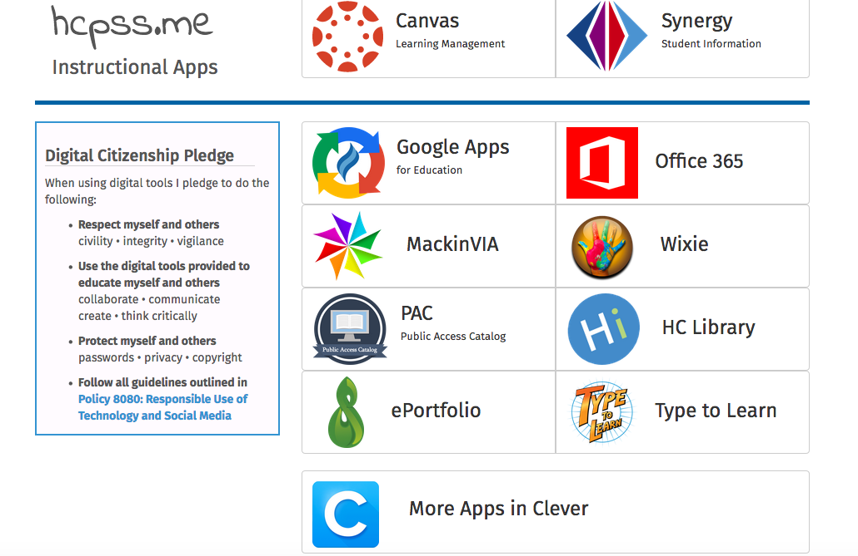

Slide 4
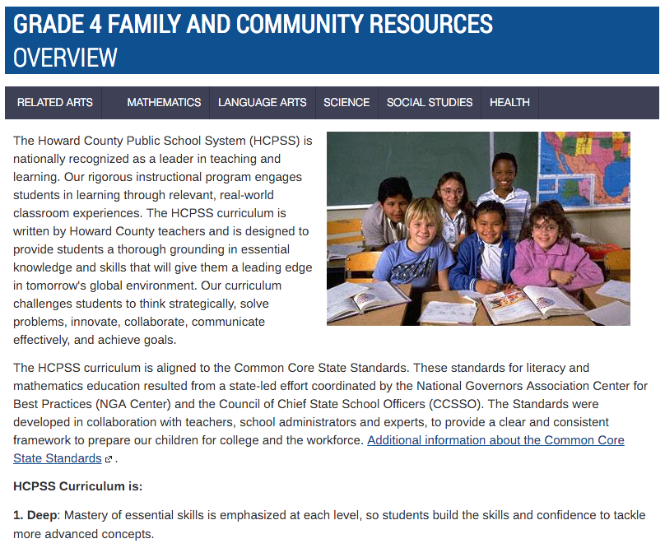
Family & Community Information on Canvas
From your canvas page, click on
Family and community resources
Notes:
Family and community resources are now located in the same place for all different content areas by grade level. So when you want to know what your 4th grader will be learning and how to help them in reading, math, social studies, etc. you will only need to navigate from one page.
https://hcpss.instructure.com/courses/34430

Slide 5
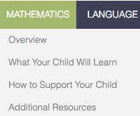
Canvas: What Your Child Will Learn
Notes:
Possible Teacher Dialogue:
This page can be found under the what your child will learn tab on the Canvas Parent Pages.
https://hcpss.instructure.com/courses/34430/pages/grade-4-star-mathematics-what-your-child-will-learn
The table shows the specific standards for each major concept area. The table also outlines during which quarter a concept will most likely be introduced. Some concepts will be introduced during one quarter and then built upon as the year goes on.
There is also a link at the top of this page to take parents to above grade level content.

Slide 6
Major Math Concepts for Fourth Grade
Whole Numbers
Fractions
Multiplication and Division
Decimals
Measurement and Data
Patterns
Geometry
Notes:
Possible Teacher Dialogue
Whole Numbers: Includes understanding place value to one million, comparing numbers, rounding and fluently adding and subtracting multi-digit numbers
Fractions: Includes understanding equivalent fractions, comparing fractions, adding and subtracting fractions and decomposing fractions
Multiplication and Division: Includes multiplying and dividing to solve word problems, identifying prime and composite numbers, finding factor pairs up to 100, multiplying multi-digit numbers and explaining calculations using equations, arrays and/or area models and dividing multi-digit numbers with single digit divisors
Decimals: Includes reading, writing and representing decimals as they relate to fractions with denominators of 10 or 100 and comparing decimals to the hundredths
Measurement and Data: Includes converting equivalent measurements in the same measurement system, adding and subtracting fractions on a line plot, applying the area and perimeter formulas for rectangles, solving measurement related word problems and understanding, measuring and drawing angles using a protractor
Patterns: Includes using shapes and numbers to create and understand patterns that follow set rules
Geometry: Includes identifying and drawing points, line segments, rays, angles, perpendicular and parallel lines, classifying figures by line segments and angles and understanding line of symmetry for 2 dimensional figures

Slide 7
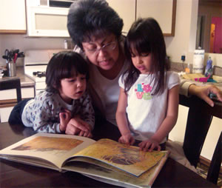
Reading Requirements
Children who are solid readers:
* perform better in school
* have a healthy self-image
* become lifelong learners
All of the these outcomes lead to our children’s viability in a competitive world.

Slide 8
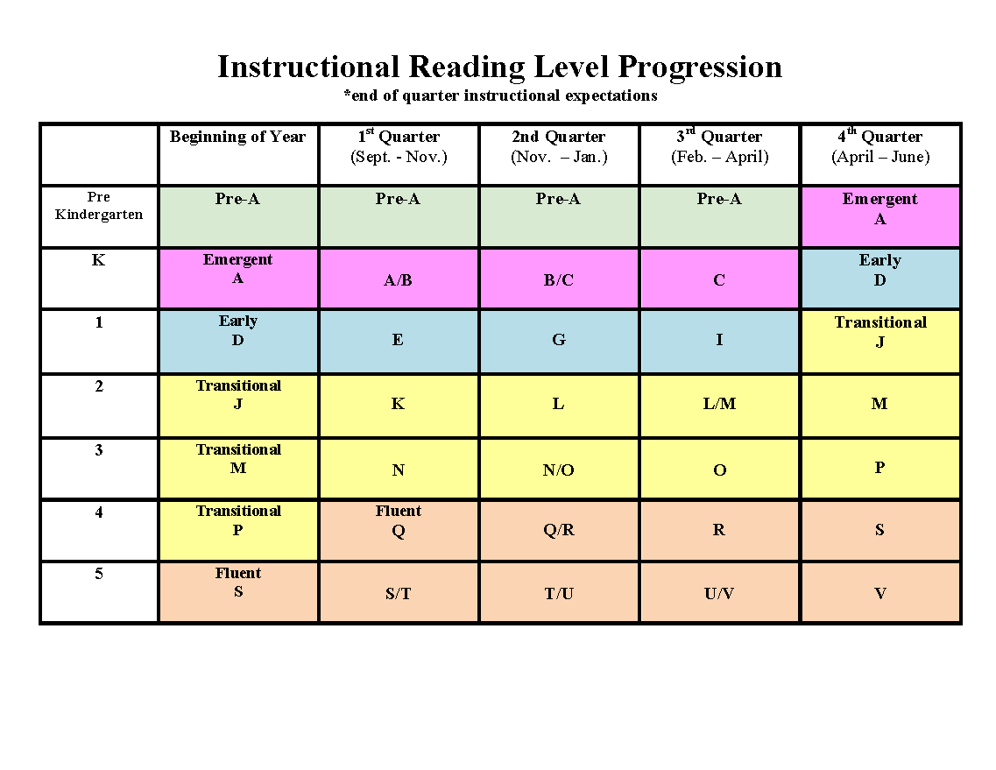

Slide 9
PBIS at Phelps Luck Elementary School
Fabulous Falcons
Respect Self
Respect Others
Respect Property
Notes:
‹#›

Slide 10
How can parents support PBIS at home?
Talk with your child about what it means to respect self, others and property at home.
Focus on the positive things that your child does at home and talk about why these behaviors are important to you.
Assist teachers in the classroom with management of the PBIS program if needed.
Notes:
‹#›

Slide 11
This year, we’re using ClassDojo to build our classroom community
We’ll build a positive culture where students are engaged, encouraged, and love learning!
All parents are part of our classroom community, seeing what we’re learning every day.

Slide 12
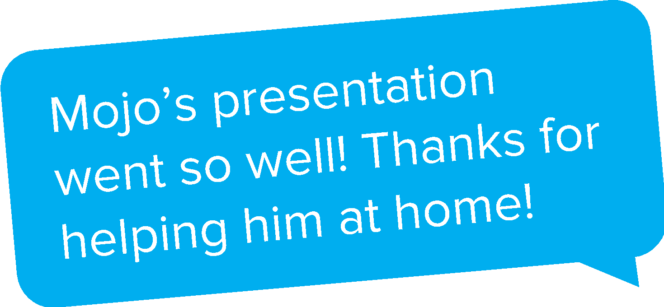
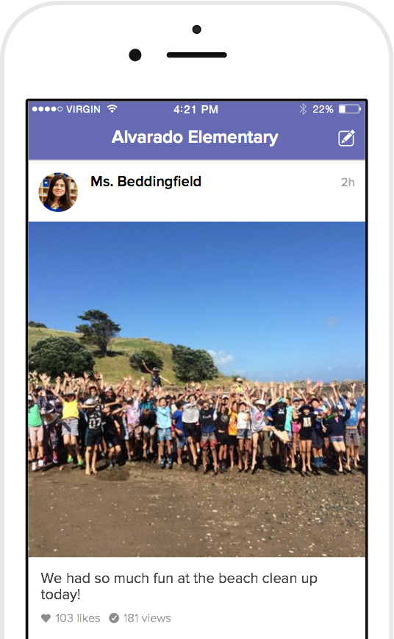
How we’ll use ClassDojo
As a teacher, I will:
Post announcements and updates regularly on Class Story
Share photos and videos of our classroom activities
Send private messages to keep you in the loop!
Students will:
Share classwork on their own digital portfolio
Only family members will be able to view their work

Slide 13
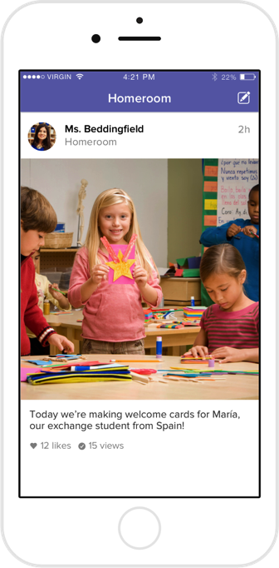
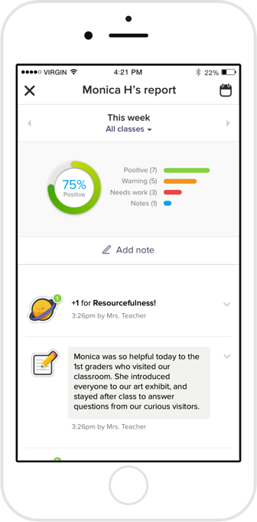
What do parents see?
You’ll see the Story of our classroom:
Photos and videos from class
Important updates and announcements
Your child’s digital portfolio
Private messaging between the two of us
Translate any message or Class Story post into your preferred language!

Slide 14
I’m always here to help if you need anything, as well as the ClassDojo team who can be reached at parents@classdojo.com

Slide 15
Accessories
Cell phones are not encouraged to be brought to school.
Students can make phone calls on the classroom phone and in the office with the help of an adult.
However, cell phones that are in school must be kept off and in the child’s backpack during the school day.

Slide 16
Attendance
School attendance is super important for academic success!
Please make sure your child is here everyday!
If your child is sick or has missed school, a note is required with the following:
First and last name of student
The date the child is absent
Reason for absence
Parent/guardian signature

Slide 17
Breakfast at PLES
Breakfast is offered to our students everyday. Participation in breakfast is completely voluntary. There is no charge for breakfast.
Breakfast is offered from 8:40-8:55. Students should arrive in time to eat breakfast so that the instructional day can begin promptly at 9:00.
Breakfast is prepackaged this year.

Slide 18
Homework Policy
The 4th grade team’s homework policy is as follows:
All students will copy their homework in their agenda/assignment book daily. The agenda book should be signed on a daily basis by a parent/guardian.
Homework can be done with adult supervision, but the student should complete the assignment.
All homework should be returned by the assigned date. Assignments not turned in on the date will not receive full credit.

Slide 19
Homework Policy Cont.
Homework is assigned daily. Notes to excuse or extend assignments will not be accepted, unless under extreme circumstances.
Students who are absent should see the teacher for each subject immediately.
Make up work (class work and homework) should be completed in a timely fashion. For every day absent, he/she will have a day to make up that work.

Slide 20
Typical ELA Homework
Read for 25 minutes and ask an adult to sign his or her reading calendar
Complete a short daily grammar review exercise
On Fridays: bring home weekly reflection journal and share weekly letter at home

Slide 21
Typical Math Homework
Math homework is given Monday through Thursday, unless there is a holiday
Homework should be independent practice of math skills
2 nights are Common Core Review and 2 nights are current skill practice

Slide 22
Conferences
November 20th and 21st

Slide 23
Lunch & Recess
Lunch costs $2.75 this year.
Money must be brought in daily or put into the students account.
Money can be added to student accounts with MySchoolBucks.com
Recess equipment will be provided by the school, please do not bring personal items from home.

Slide 24
Teacher Contacts
4th Grade Teachers:
Kelly Fleck (ITL) - kelly_fleck@hcpss.org
Lindsay Menton - lindsay_menton@hcpss.org
Kristen Arnold – kristen_arnold@hcpss.org
Jordan Green – jordan_green@hcpss.org
Terri Royster (Para-educator)

Slide 25
Teacher Contacts
4th Grade Co-Teachers:
Mary Tatum- mary_tatum@hcpss.org
Mary Ellen Davis- maryellen_davis@hcpss.org
Kara Emond- katherine_emond@hcpss.org
Lisa Anderson - lisa_anderson@hcpss.org
Karen Simcock- karen_simcock@hcpss.org
Kaleigh Thomas- kaliegh_thomas@hcpss.org
Jennifer Lebro - jennifer_lebro@hcpss.org
Keri Golibart - keri_golibart@hcpss.org

