Slide 1
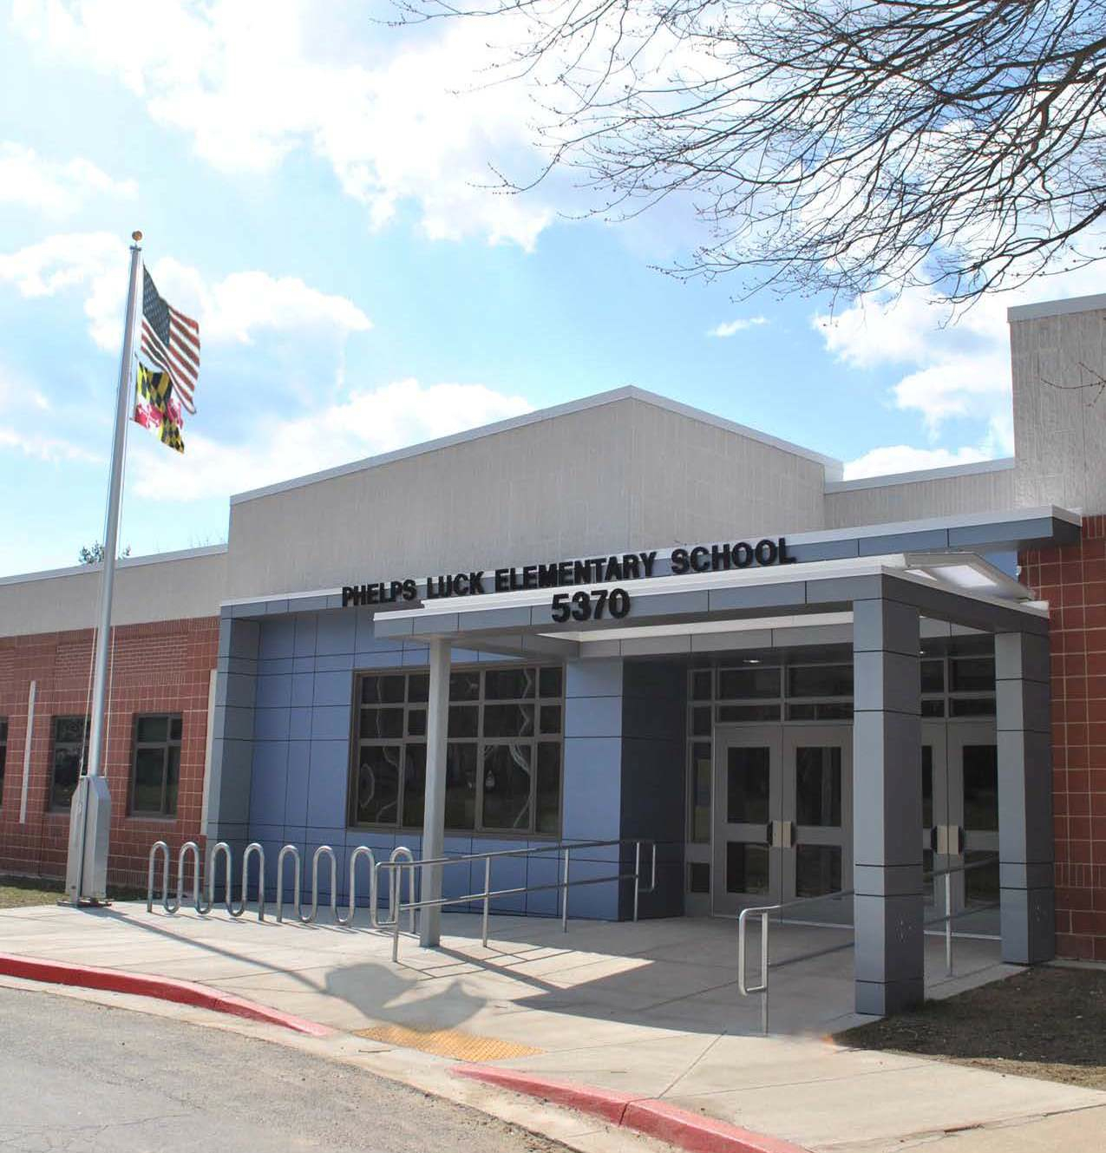
Back to School Night Phelps Luck Elementary School

Slide 2
PLES Parent Teacher Association (PTA)
The PTA is a group of parents and teachers who volunteer their time to provide academic, social, and cultural enrichment to each student at PLES throughout the school year.
Executive Committee:
Jackie Cholewczynski – President
Steve Tabak – Vice President 1 (Financial Oversight)
Amy Shupps – Vice President 2 (Fundraising)
Michele McGee-Guthrie – Vice President 3 (Teacher Liaison)
Ann Wacha – Treasurer
Kelly Frank – Secretary

Slide 3
Membership Q&A
How much is it to be a member of the PTA?
$10 per person, per year
What does membership mean?
Membership means you are able to vote on PTA matters at our monthly meetings
When are the PTA meetings?
First Wednesday of every month (except September and January) at 7pm in the Media Center
Are meetings mandatory?
NO!
Do I have to be a member to volunteer at PTA events?
NO!
Do I have to volunteer a certain number of times as a member?
NO! We will take all the time you can give. We recognize that people work and so do most of us!
Who attends the PTA meetings?
Parents, grandparents, relatives and best of all, our Principal Mrs. Leader and Assistant Principal Mrs. Fowlkes

Slide 4
What does the PTA do?
Fundraising
Dine Out Nights, Fall/Spring Fundraisers, Box Tops for Education, Spirit Wear
Enrichment
Book Fairs, Science Fair
Wellness
Family 5K And Family Fun Run
Social Activities
Paint Nights, Dances, Movie Nights, Bingo Night
Staff Appreciation
Back to School Teacher Breakfast, Conference Dinners, Teacher Appreciation Week
Community Outreach
Mobile Food Pantry
Funding
Field Trips, Cultural Assemblies. Simulated Congressional Hearings
Publications
Yearbook, School Directory

Slide 5
Upcoming Events
First PTA Meeting: October 4th, 7pm in the Media Center
Fall Paint Night: October 10th, 6:30 – 8:00pm in the Cafeteria
Dine Out Night: October 17th
Fall Fundraiser (Cherrydale): End of October
November PTA Meeting: November 1st, 7pm in the Media Center
Fall Movie Night: Thursday, November 9th, 6:30 – 8:00pm in the Cafeteria
Dine Out Night: November 14th
December PTA Night Featuring Interim Superintendent Dr. Martirano: December 6th, 7pm in the Media Center

Slide 6
School News and Information
Email
Print
Social Media
Video
In Person
Notes:
These are various ways we communicate information.

Slide 7
HCPSS System and School News
Email
Text
School News
HCPSS News
Emergency Notices
Optional for
Emergency Notices
Only
Details: www.hcpss.org/hcpss-news/

Slide 8
Mobile App
Notes:
The HCPSS Mobile App is available free to download for iphones, iPad, and Android devices in the app stores (search for “HCPSS”).
The app makes it quick and easy to find the information you need, when you need it. It provides:
Simplified access to information
On-the-go access and quick links
School menus
Compiled messages and calendar dates from all of the schools that your children attend, as well as school district information.

Slide 9
SYNERGY STUDENT
INFORMATION
SYSTEM
CANVAS
LEARNING
SYSTEM
FAMILY FILE
www.hcpss.org/connect
Notes:
Please log-on to update your child’s emergency information.

Slide 10
Title I
School-wide enhanced programs and services
Family involvement
Notes:
PLES is one of 12 Title I schools in Howard County. Title I is a federally funded program designed to ensure all children have an opportunity to access a high quality education.
Title I federal funding is used to support and enhance the school program, and provide additional academic support, for every child in the school.

Slide 11
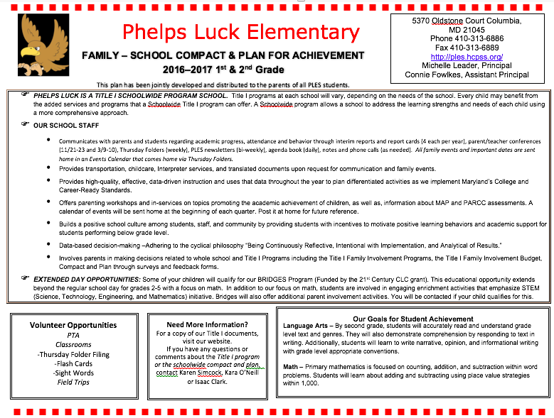
Primary Compact
These bullets explain the Title I Schoolwide Program at PLES.
Bridges is funded by Title I funds. Here’s a description of what it offers!
The bottom row offers an insight into volunteer opportunities, your Title I Points of Contact, and overall academic goals in Math and Reading

Slide 12
Title I Family Events
October 30 – Reading Night with Trunk-or-Treat – 6:30-8:00pm
Each grade is working to determine nights to support parents with their child’s academics. More info to come!

Slide 13
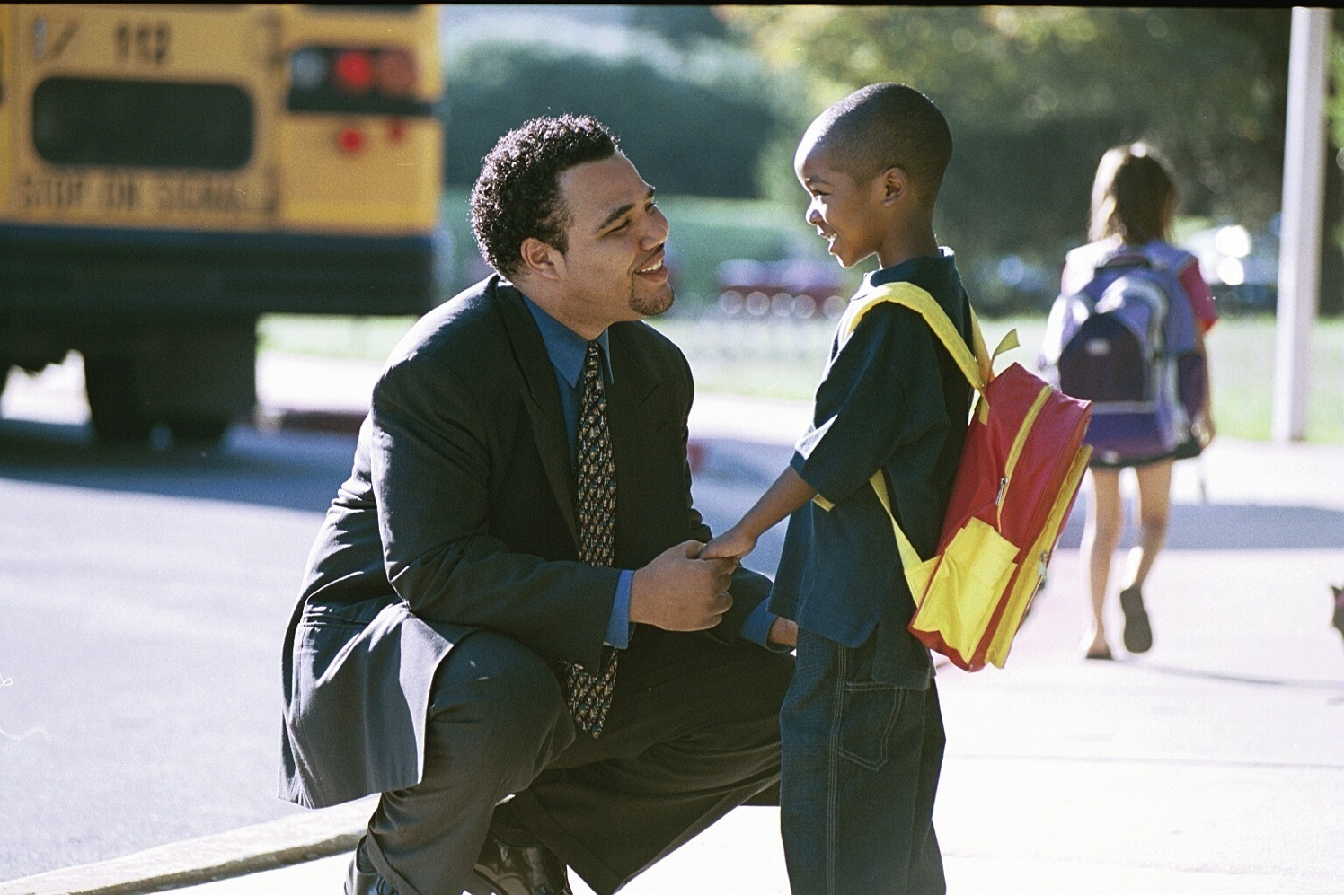
Attendance
First bell is 8:40a.m. – in class by 8:55a.m.
Children should only be absent for illnesses.
Notes are required for absences: child’s full name, date of absence, reason, and parent signature.
3 discretionary days a year – fill out pre-approval form 2 weeks in advance.

Slide 14
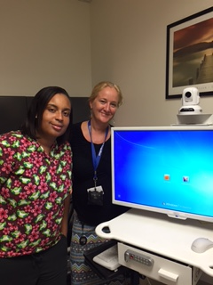
Telehealth
Goal – Promote Health and Well Being Among Students While Providing Another Layer of Service to our PLES Families
Optional Participation (Parental Discretion)
Site Based Acute Care Diagnosis
Strep Throat
Ear Infections
Rash Identification
Eye Infections
Chest Infections

Slide 15
Measures of Academic Progress (MAP)
Notes:
MAP is administered in grades 1-5.

Slide 16
PARCC Assessment
Notes:
Connie
PARCC (Partnership for Assessment of Readiness for College and Careers is the name for the standardized reading, writing and mathematics assessments implemented in all Maryland schools. PARCC assessments are directly aligned to the Common Core standards and is administered to students in grades 3, 4, and 5.

Slide 17
CogAT (Cognitive Abilities Test) - Grades 3-5
Measures verbal, quantitative, and learned reasoning abilities
Used for GT placement decisions
Notes:
CogAT – Grades 3 and 5
CogAT (Cognitive Abilities Test) is used to make student placement decisions for Gifted & Talented (G/T) programs. CogAT measures students’ verbal, quantitative and nonverbal reasoning abilities: the three areas most closely related to success in school.

Slide 18
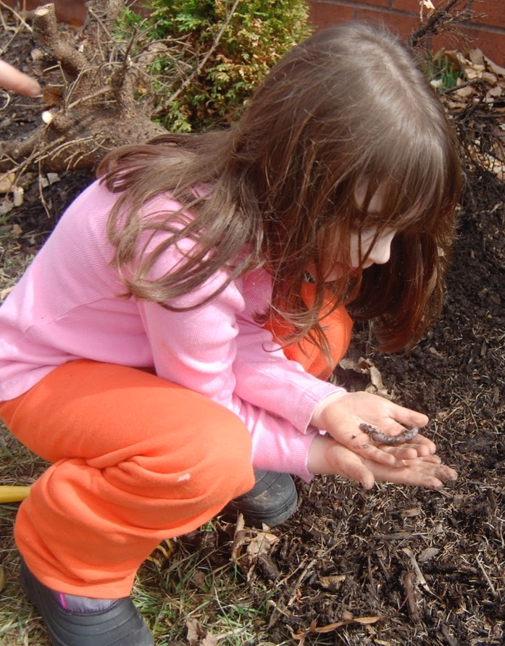
Maryland Integrated Science Assessment (MISA)
Aligned to Next Generation Science Standards (NGSS)
Earth/Space science
Life science (biology)
Physical science (chemistry and physics)
More information: nextgenscience.org
Notes:
MISA (Maryland Integrated Science Assessment) is the standardized science assessment, developed and implemented by the Maryland State Department of Education (MSDE). It is an on-line test administered to 5th grade students.

Slide 19
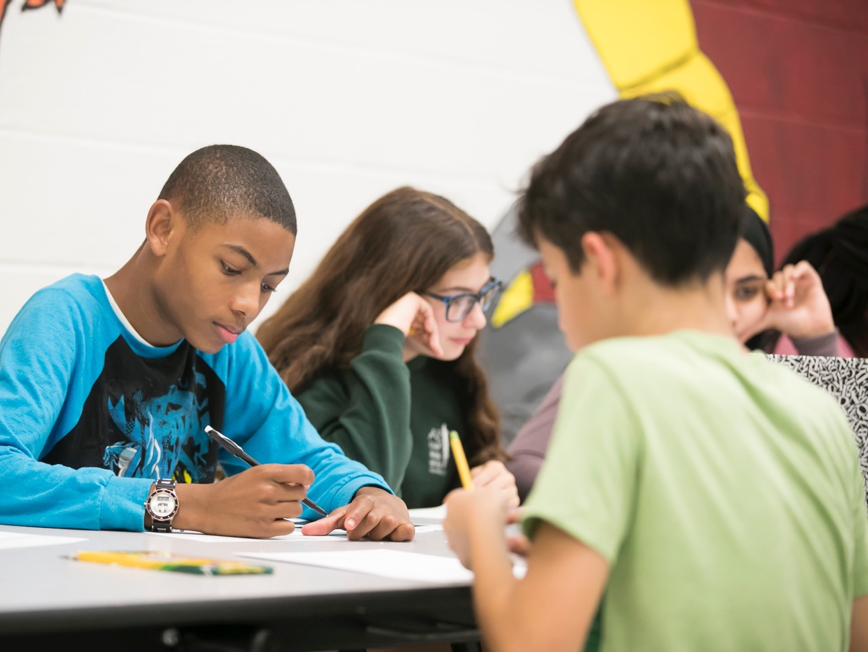
What Your Child Will Learn Guides
CANVAS
Notes:
These guides can be found on the Canvas page.

Slide 20
Classroom Visits
3rd Grade: Homeroom Classrooms
4th Grade: Fleck/Green – Fleck’s Room
Arnold/Menton – Arnold’s Room
5th Grade: Lardner/Angle/Skinner – Skinner’s Room
Milton/Rembert – Rembert’s Room

