Slide 1
Welcome! Math & Science Team: Mrs. Fleck & Ms. Lardner
Academic Session 1 Presentation: 7:30-8:00
Academic Session 2 Presentation: 8:00-8:30

Slide 2
Schedule
8:40-9:00 Arrival and Breakfast
9:00-9:45 Academic Session 1
9:45-10: 15 Spanish
10:15-11:00 Specials
11:00-12:15 Academic Session 1
12:15-1:00 Academic Session 2
1:00-2:00 Recess & Lunch
2:00-3:15 Academic Session 2
3:15-3:25 Pack up and Dismissal

Slide 3
What Will Our Students Learn?
Grade 4
Problem Solving and Application
Place Value
Addition/Subtraction
Multiplication/Division
Fractions
Decimals
Area/Perimeter
Geometric lines and angles

Slide 4
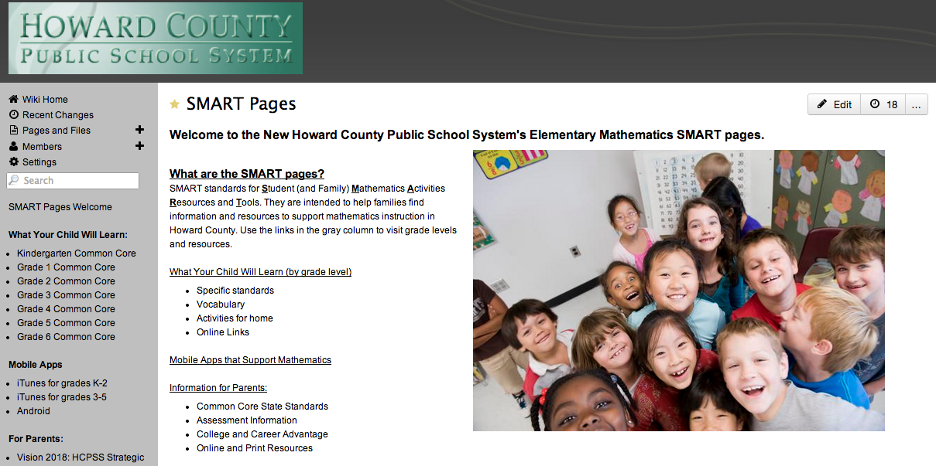
How can I help my child? : SMART PAGES
http://smart.wikispaces.hcpss.org
What Your Child Will Learn
• skills/concepts taught
• vocabulary
• activities at home
• links for games
Navigating the Site
Mobile Apps
Resources for Parents
• Vision 2018
• Information about Common Core
• Books

Slide 5
Where Can I Get More Information?
HCPSS SMART Pages
More information about the Common Core State Standards
Specific grade level standards, vocabulary,
Optional activities you can do at home to support your student including websites and Apps.
http://smart.hcpss.wikispaces.net

Slide 6
Attendance
All students must attend school every day unless the student is sick by Maryland Law.
Our school goal expects a 96% attendance rate for the year.
All students who receive 96% attendance for a quarter receive an Exemplary Attendance Award.
Notes are required when a student is absent:
First and last name of student
The date the child is absent
Reason for absence
Parent/guardian signature

Slide 7
Attendance Continued
Doors open for students at 8:40a.m. Please do not send your child before 8:40a.m. as supervision is not provided until that time.
Students need to be at school and in their classrooms by 8:55a.m. in order to be considered on time and not tardy. If your child should arrive after 8:55a.m., please bring your child to the office and sign them in.
We ask that there not be any early dismissals after 3p.m.

Slide 8
Breakfast at PLES
Breakfast is offered to our students everyday. Participation in breakfast is completely voluntary. There is no charge for breakfast.
Breakfast is offered from 8:40-8:55. Students should arrive in time to eat breakfast so that the instructional day can begin promptly at 9:00.
Breakfast is prepackaged this year.

Slide 9
Math Homework Policy

Slide 10
Conferences
November 23 & 24: Conference with Academic Session 1 Teacher
February 4: Conference with Academic Session 2 Teacher

Slide 11
Study Guides
Students will receive study guides before quarterly math assessments.
To build the fundamental skills essential for developing academic independence
Parents will be notified of upcoming quarterly assessments via agenda books
Students will bring home their journals home for unit assessments.
Notes:
Decision was made because of feedback from middle school teachers and parents
The type of study guide (outline v. questions answer) will depend on the type of assessment.

Slide 12
Lunch & Recess
Lunch costs $2.75 this year.
Money must be brought in daily or put into the students account.
Money can be added to student accounts with MySchoolBucks.com
Recess equipment will be provided by the school, please do not bring personal items from home.

Slide 13
Teacher Contacts
4th Grade Teachers
Keri Golibart (ELA Team Leader)- keri_golibart@hcpss.org
Kelly Fleck (Math Team Leader)- kelly_fleck@hcpss.org
Lindsay Menton- lindsay_menton@hcpss.org
Amanda Lardner- amanda_lardner@hcpss.org
Terri Royster (Paraeducator)- terri_royster@hcpss.org
4th Grade Co-Teachers
Jennifer Silbaugh (Special Educator)- jennifer_silbaugh@hcpss.org
Art Wong (ESOL)- art_wong@hcpss.org
Tracy Jones- tracy_jones@hcpss.org
Mary Ellen Davis- maryellen_davis@hcpss.org
Kara O’Neill- katherine_oneill@hcpss.org
Karen Simcock- karen_simcock@hcpss.org

