Slide 1
Welcome to Back to School Night
2017-2018
Grade 3
Phelps Luck Elementary School

Slide 2
Third Grade Team
Ms. Bennett
(Mrs. Lane - Long Term Sub)
Mrs. Johnson
Mrs. McCann
Mrs. Metcalfe
Ms. Zester
Notes:
Gretchen

Slide 3
Our Daily Schedule
8:40 - 9:00 Arrival in Homeroom, Breakfast, Unpack
9:00 - 10:15 Math
10:15 - 11:00 Content (Science/Social Studies/Health)
11:00 - 11:45 Related Arts (PE twice each week, Music, Art, Media)
11:45 - 12:15 Spanish
12:15 - 1:00 Writing
1:00 - 1:15 Reading
1:15 - 1:45 Lunch
1:45 - 2:15 Recess
2:15 - 3:15 Reading
3:20 Dismissal
Notes:
Switching at 9:00 - Math
Lunch is late!

Slide 4
New for Third Grade
Report Card
Orchestra
PARCC
Multiplication and Division
Agenda Book
Binder and Supplies
Notes:
Have sample agenda book ready
Have sample binder and pencil bag ready

Slide 5
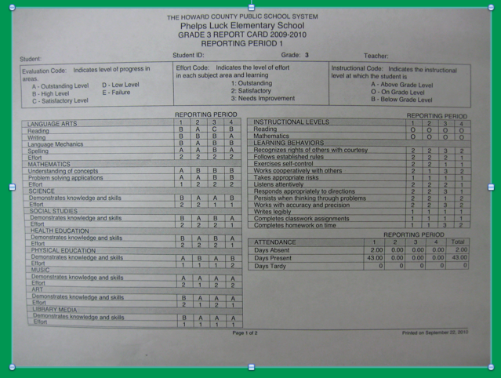
Notes:
Have a copy of the report card for families

Slide 6
Grading Policy
Each grade is comprised of:
Classwork, Assessment Items and Homework Completion
The majority of each grade is comprised of an average of the classwork tasks completed that quarter.

Slide 7
P.B.I.S. at PLES
Respect SELF Respect OTHERS
Respect PROPERTY
PBIS focuses on acknowledging students for consistent positive behaviors.
Staff and students build positive relationships.
Routines and language are consistent throughout the school.

Slide 8
Let’s Create an Amazing Classroom Community! Class Dojo!
We’ll build a positive culture by encouraging skills like “Helping others” and “Perseverance”.
We want all parents engaged in our classroom, seeing what we’re learning every day!

Slide 9
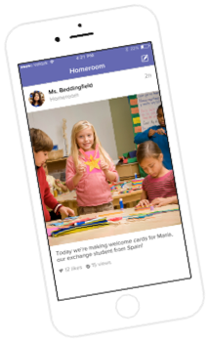
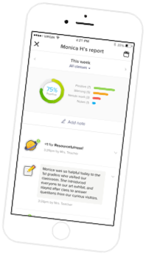
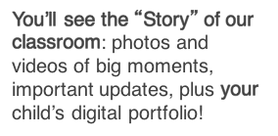
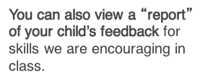
How Dojo keeps you involved!
Notes:
The class story is public for everyone. Messages and student stories are private for just those registered to the student’s account.
Dojo Points
DoJo points are incentives that are earned throughout the school day.
When a student demonstrates the expected behaviors, (Respecting self, others, and property) they receive DoJo points.
DoJo points are redeemed for incentives in the classroom, team, or school-wide.

Slide 10
PBIS -- Incentives
Team-wide incentives
Team-wide monthly incentives include many of the following activities:
•Themed Relay Races
School-wide incentives
At the end of each quarter, all students will participate in a school-wide incentive.
Some incentive ideas are:
•DROP EVERYTHING AND DANCE!
•Fine Dining Friday
•Gift card raffles (4th quarter)

Slide 11
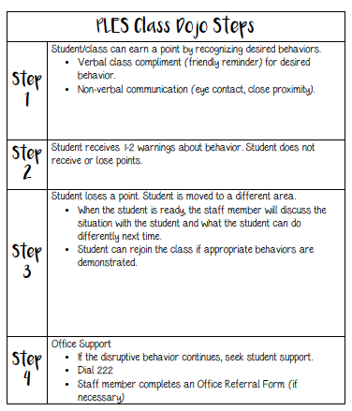
Notes:
By the time students lose a Dojo point they have had non-verbal and at least 1 verbal reminder.

Slide 12
How can you support PBIS at home?
Talk with your child, share examples of respectful behavior!
Celebrate the positives!
Talk about behaviors that are important to you!
Review the PBIS parent flyer that will be going home soon.
Have conversations about lost Dojo points - set goals!
Notes:
Talk with your child! about what it means to respect self, others and property at home.
If you notice your child lost a point, discuss what caused it to happen and what can he or she can do in the future

Slide 13
Breakfast/Cafeteria
Breakfast is offered to all of our students everyday. Participation is voluntary and free.
Breakfast is offered in the classroom from 8:40-8:55.
Instruction starts at 9:00.
School lunch price is $2.75
All students have a lunch account (6-digit PIN)
Money can be added to this account online or cash can be brought in and given to Mrs. Metcalfe (change is not available)

Slide 14
Communication
Agenda Books
Thursday Folders
Dojo!
3rd Grade Teacher Website -- CANVAS **Coming soon!
3rd Grade Team Website -- CANVAS **Coming soon!
School Website: http://ples.hcpss.org
Parent-Teacher Conferences (November)
Progress Reports and Report Cards

Slide 15
Dismissal
Students must have a note for any dismissal changes
This includes Bridges, Girls on the Run, etc.
Walkers and car riders leave with Mrs. Metcalfe
Once walkers exit the building they are expected to walk home
Car riders must walk down the sidewalk with Mrs. Metcalfe
For safety purposes, students must notify Mrs. Metcalfe prior to getting in a vehicle

Slide 16
What does math look like each day?
•75 minutes daily
•Begins with a high-quality number routine
•Standards based instruction: high quality tasks, variety of representations, purposeful questions, and student discourse
•Closure everyday

Slide 17
What will Our Students Learn?
Place Value
Solidify Addition and Subtraction
3rd Grade Math -- Standard Algorithm not Required
4th Grade Math -- Standard Algorithm Required
Learn Multiplication and Division
Fractions
Elapsed Time
Area and Perimeter
Attributes of Shapes

Slide 18
Basic Facts
Students will learn ALL basic facts for multiplication and division.
September/October: 2’s, 5’s, 10’s
November/December: 0’s, 1’s, 3’s
January/February: Review of what we’ve learned
March/April: 6’s, 9’s
May/June: 4’s, 7’s, 8’s
Once students learn all multiplication and division facts fluently, they can earn a Fast Fact Falcon shirt!

Slide 19
Math Homework
The purpose of homework at this age is to practice already learned skills. Also, the “habit”.
Your child will receive math homework
Monday -- Thursday
Two nights each week: CC Review Homework
Two nights each week: Current Skill Practice
Selected skill practice homeworks are intended to be completed independently.

Slide 20
Next Generation Science Standards
Quarter 1: Weather and Climate
Quarter 2: Forces and Interactions
Quarter 3: Interdependent Relationships in Ecosystems: Plant and Animal Survival
Quarter 4: Inheritance and Variation of Traits: Life Cycles and Traits
Each quarter ends with a culminating activity. We will be looking for volunteers to help facilitate these.

Slide 21
ELA Daily Schedule
Reading (75 minutes)
Readers workshop and small group instruction
Writing (45 minutes)
Writing stories and opinion pieces

Slide 22
Social Studies
Quarter 1: Changing Communities
Quarter 2: Mapping Our World
Quarter 3: Money Matters
Quarter 4: Project Citizen
Notes:
Quarter 1 focuses on
Life in historic Ellicott City
Changes in communication and transportation
Changes in technology
Impact of global trade
Impact of natural disasters
Quarter 2
World map
U.S. Regions
Geography and people
Immigration
Sharing and borrowing culture
Quarter 3 focus
Decision making
Supply and demand
Saving money
Borrowing money
Creating a budget
Quarter 4 focus
Civic virtue and democratic principles
Taxes
Community goods & services
Leaders in community
Community problem solving

Slide 23
ELA Homework
To begin the year, students’ homework will only be to read at least 20 minutes a night.
Writing homework will be included later in the year!

Slide 24
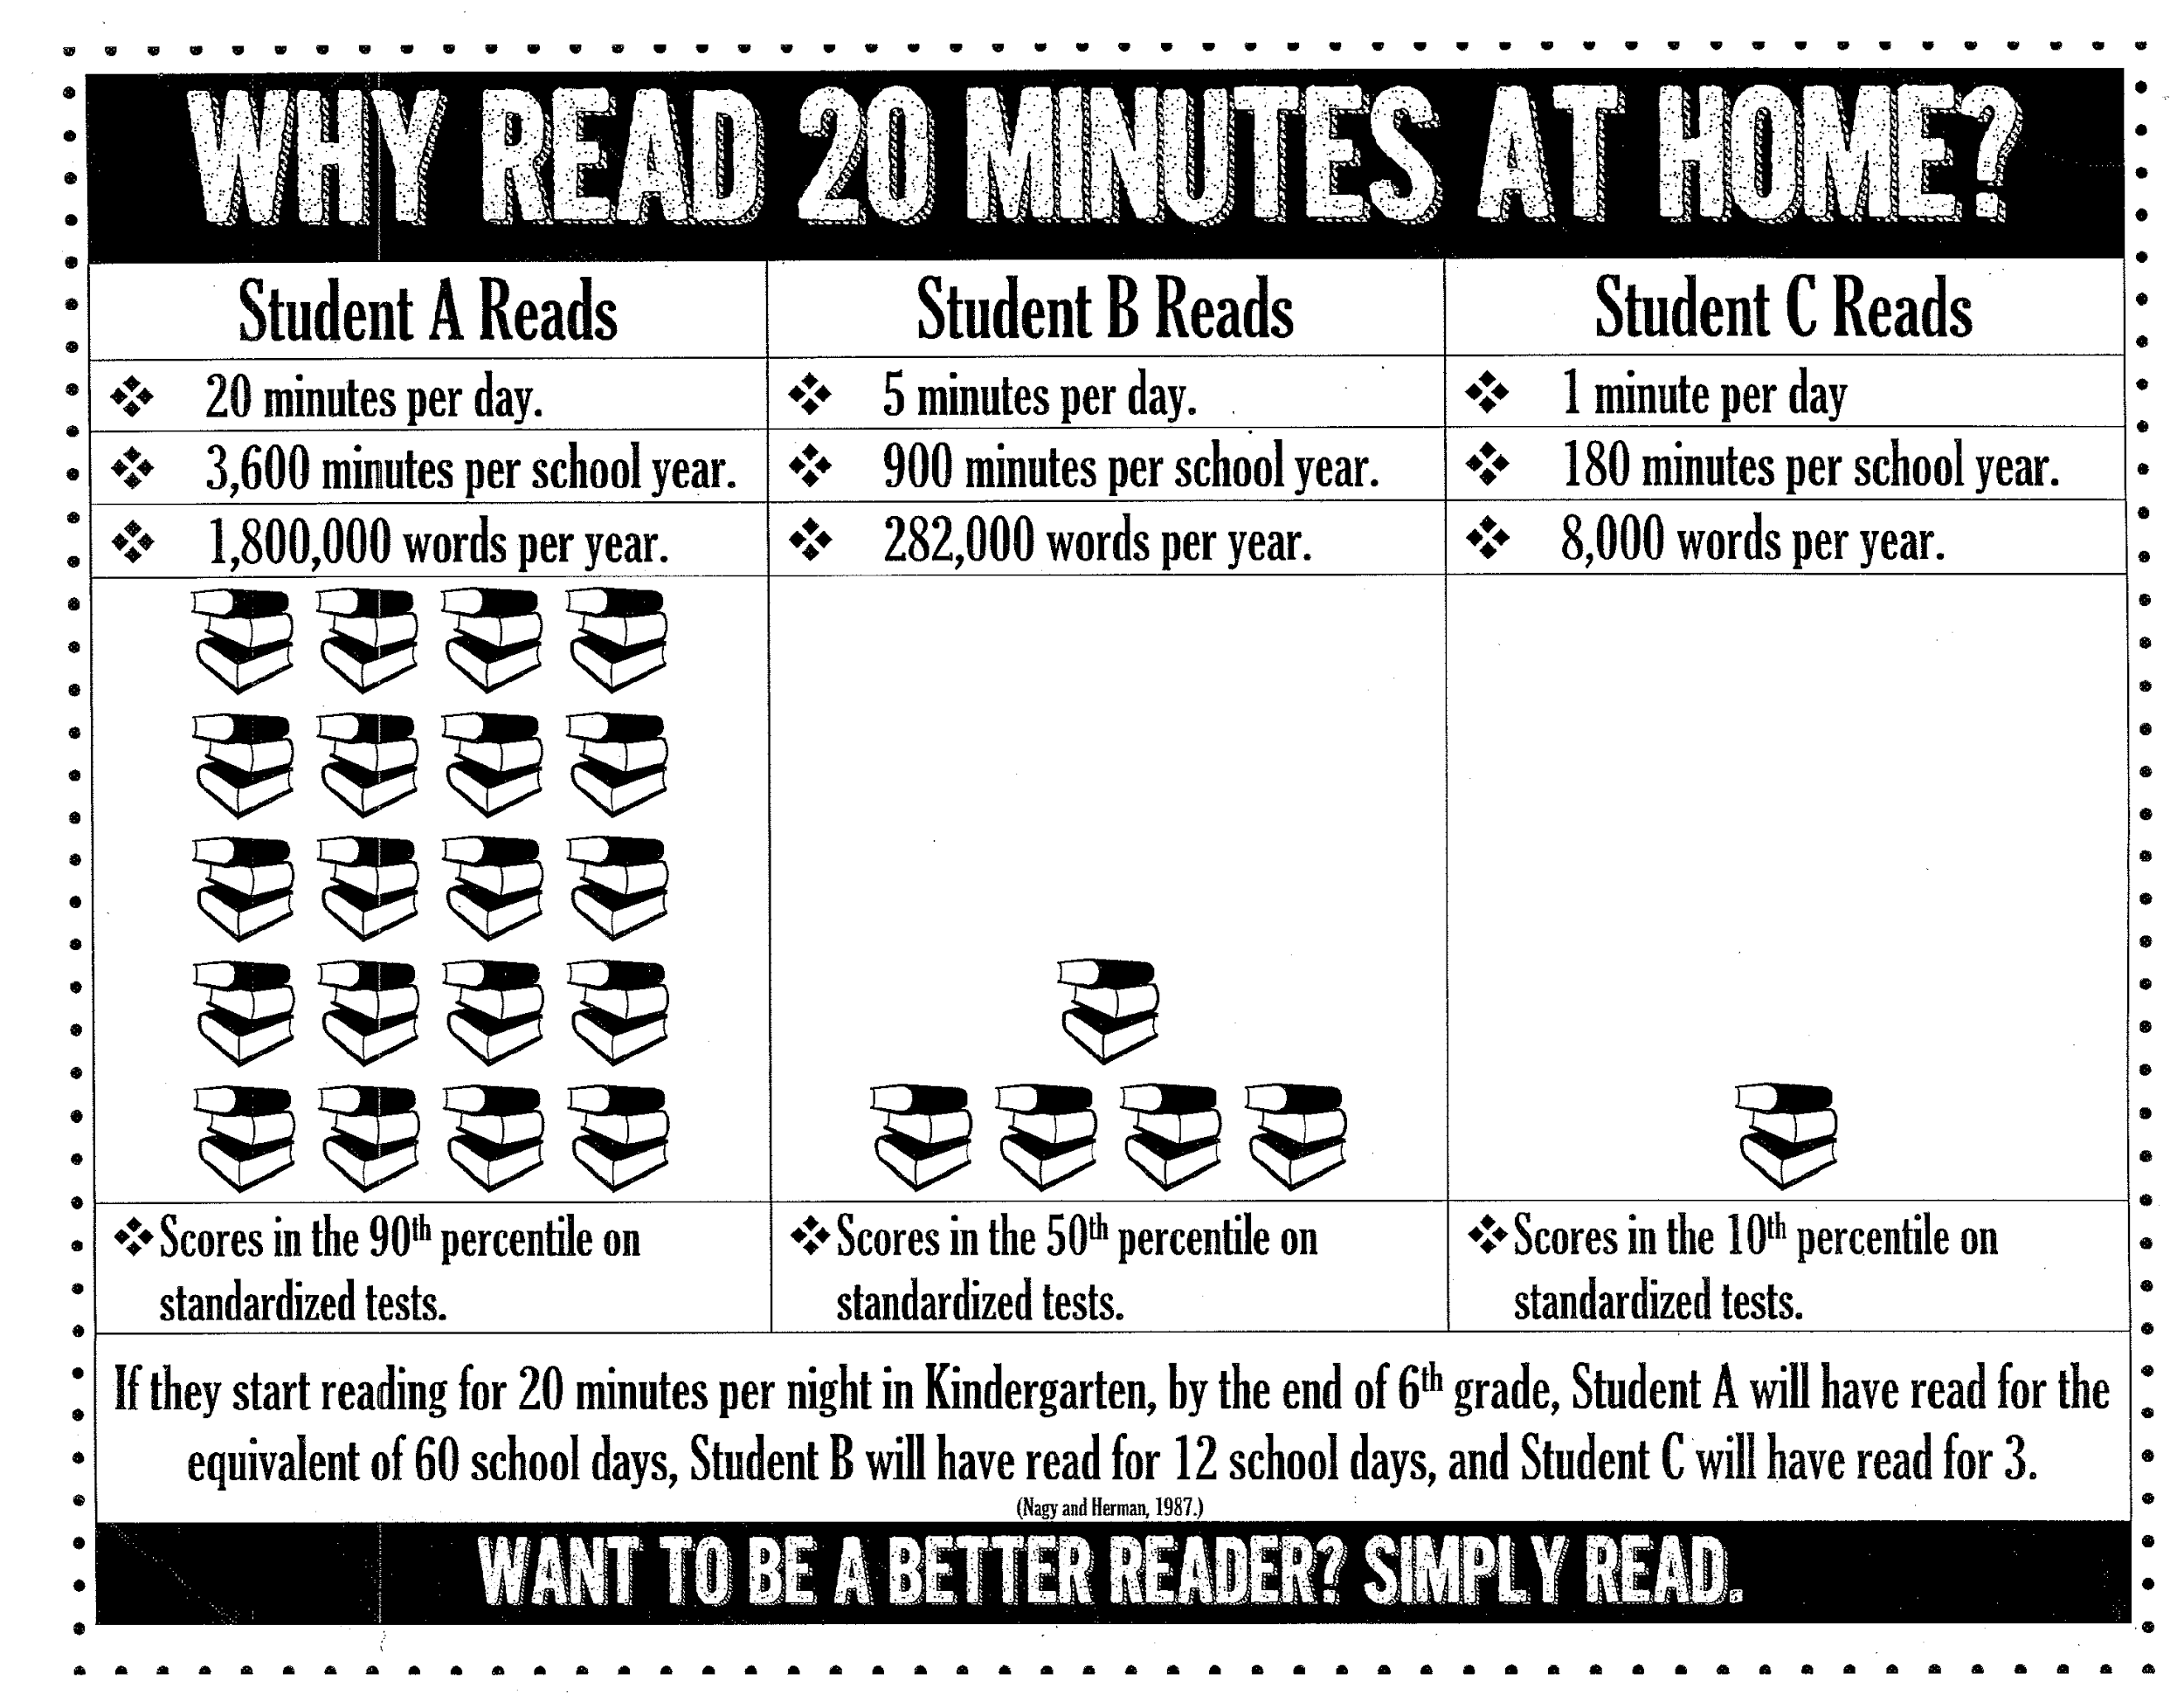

Slide 25
How can you help at home?
Nightly reading – build stamina!
~ Pick books that fit
~ Praise & ask questions
Writing practice – build stamina!
~ Praise & ask questions
~ Have your child respond with evidence or details

Slide 26
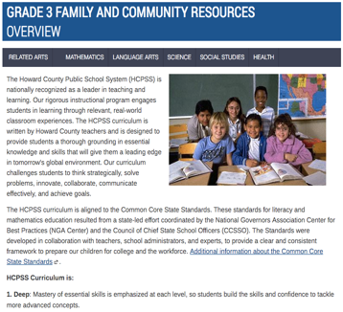
Family & Community Information on Canvas
Notes:
Family and community resources are now located in the same place for all different content areas by grade level. So when you want to know what your 3rd grader will be learning and how to help them in reading, math, social studies, etc. you will only need to navigate from one page.
https://hcpss.instructure.com/courses/34429#

Slide 27
Questions...

Slide 28
Thank you!!
Thank you for coming tonight! We are looking forward to working with you and your children this year! If you ever have any questions or concerns, please do not hesitate to contact us!

