Slide 1
Back to School Night 1st Grade
2017-2018
Notes:
NEED: Homework folder, Thursday Folder, Class Dojo parent account, Copies of Dojo form

Slide 2
Meet the teachers!
Mrs. Ashmore
Mrs. Bae
Ms. Bainbridge
Mrs. Brogan
Ms. Norris

Slide 3
Class Dojo
We will be using Class Dojo as part of our PBIS program.
We will also be focusing on building important life skills such as working hard and participating.

Slide 4
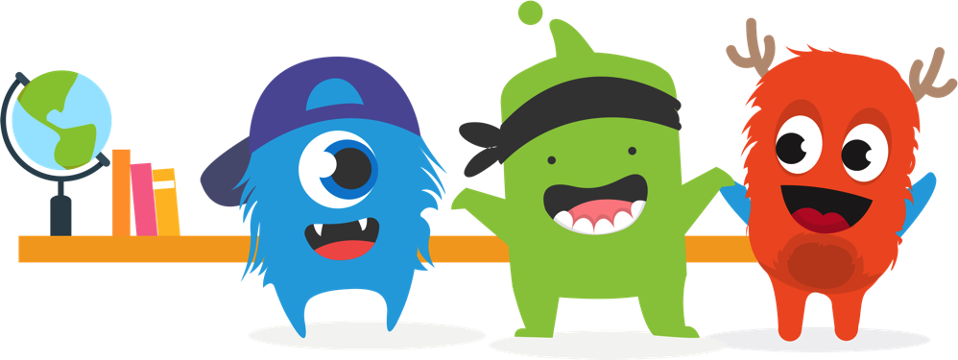
Let’s create an amazing
classroom community!
We’ll build a positive culture by encouraging skills like “Helping others” and “Perseverance”.
We want all parents engaged in our classroom, seeing what we’re learning every day!

Slide 5
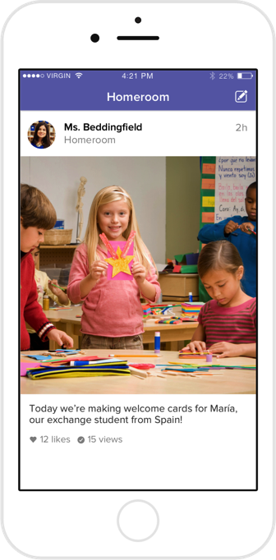
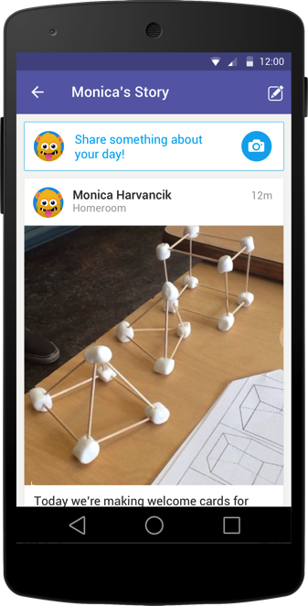
How we’ll use ClassDojo :)
As teachers, we will:
Post important updates and announcements
Share photos and videos of our classroom activities
Share your child’s classwork on his or her own digital portfolio. Only you will be able to view work posted on your child’s portfolio.

Slide 6
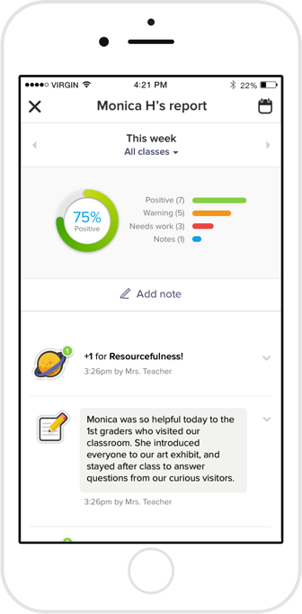
What do parents see?
You’ll see the “Story” of our classroom: photos and videos of big moments, important updates, plus your child’s digital portfolio!
You can also view a “report” of your child’s feedback for skills we are encouraging in class.

Slide 7
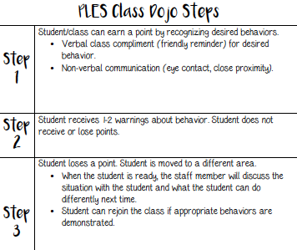

Slide 8
A typical first grader’s day…
Breakfast/Arrival 8:40-9:00
ELA 9:00-11:00
Lunch 11:00-11:30
Recess 11:30-12:00
Math 12:00-1:15
Content (Science, Social Studies, Health) 1:15-2:00
Spanish 2:00-2:30
Related Arts 2:30-3:15
Dismissal 3:25

Slide 9
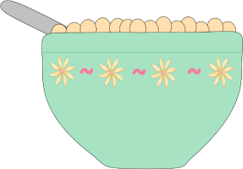
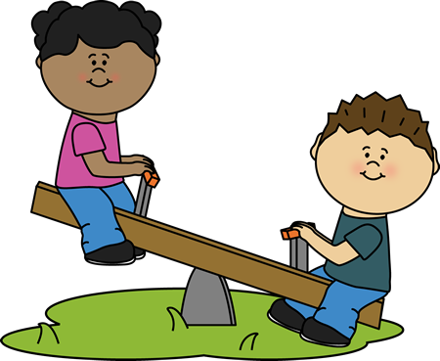
Breakfast
Ends at 9:00
Free to all students
If your child is a walker/car rider and wants to eat breakfast, please be sure he or she arrives early enough.

Slide 10
ELA (English Language Arts)
Whole group reading instruction
Small group reading and writing instruction
Daily 5

Slide 11
Small Group Reading Instruction
Decoding
Vocabulary
Fluency
Comprehension

Slide 12
Sight Words
Words that are immediately recognized
5 minutes of practice daily can greatly improve reading skills!
Examples: said, the, and, what, through, been

Slide 13
Lunch & Recess
Lunch:
PLES cannot lend money for lunch according to the Food Services policy.
Salad bar!
Please help your child learn his or her PIN NUMBER.
Recess:
Dress your child for the weather!
Label your child’s belongings.
Notes:
We go outside in temperatures down to 20 degrees with wind chill factor and up to 95 degrees.

Slide 14
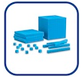
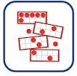
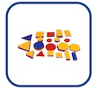
Major Math Concepts
Number Concepts
Numbers and Operations
Time
Measurement and Data
Geometry

Slide 15
Basic Facts
Basic fact flash cards practiced nightly for 10 minutes
+/- 1 and 2
+/- Making ten and +/- 0
+/- Doubles/Halves
+/- 10
You will receive notifications quarterly with your child’s scores

Slide 16
Math components
Number Routines
Standards-Based Instruction: Engaging tasks, Variety of Representations, Purposeful Questions, and Student Discourse
Differentiated Instruction
Math journal
Additional staff: Mr. Clark, Mrs. O’Neill, Dr. Stevens

Slide 17
DreamBox Online Learning
Dreambox Learning is an online software provider that focuses on mathematics education at the elementary and middle school level.
Over 1,800 lessons presented as animated adventures, games, and challenges!
Badges, coins, and unlockable mini-games are integrated into the program to reward and engage students.
Dreambox Learning software utilizes an intelligent adaptive learning engine, which identifies a student's skill level and tailors each child's experience to increase learning opportunities before proceeding to new learning objectives.

Slide 18
DreamBox Online Learning

Slide 19
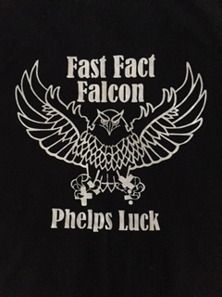
Fast Fact Falcon Program
With your child’s hard work and home practice, he/she will earn a fast fact falcon t-shirt after passing first grade facts!

Slide 20
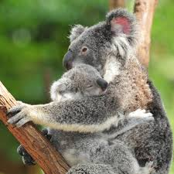
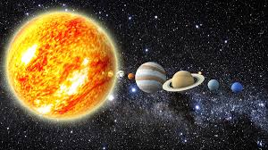
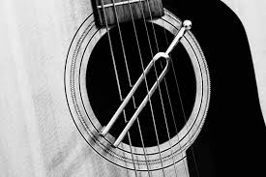
Science Units
Quarter 1 | Quarter 2 | Quarter 3 | Quarter 4
Plant and Animal: Structure and Function | Patterns in Space Systems | Light | Sound
Notes:
Q1: Adult plants and animals can have young. In many kinds of animals, parents and their offspring engage in behaviors that help the offspring survive.
Animals have body parts that capture and convey different kinds of information needed for growth and survival. Animals’ behavior in reaction to this information can help them survive.
Young animals are very much, but not exactly, like their parents. Plants also are very much, but not exactly, like their parents.
Q2: The sun, moon, and stars move in a predictable pattern that can be observed, described clearly, and predicted ahead of time.
Patterns (such as sunrise, sunset, seasons, and stars) can all be observed, described, and predicted ahead of time.
Q3: Objects can be seen if light is available to shine on them. Objects can also be seen if they give off their own light.
Some materials allow light to pass through them (transparent), some materials allow only some light to pass through (translucent), and others block all the light and do not allow light to pass through (opaque).
Light can be used to communicate over long distances.
Q4: Sound can make materials vibrate.
Vibrating material can make sound.
People have created and used a variety of devices to make sounds that communicate over long distances.

Slide 21
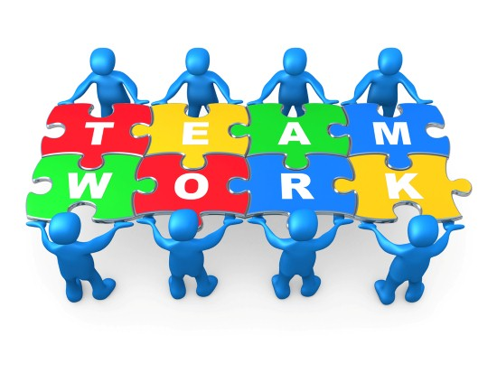
Social Studies Units
Quarter 1 | Quarter 2 | Quarter 3 | Quarter 4
Working Together | Our World of Cultures | Communities at Work | Our Changing World

Slide 22
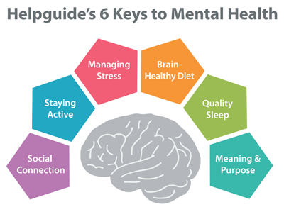
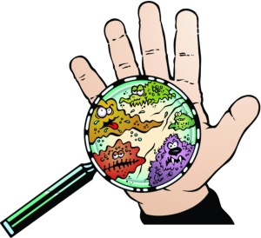
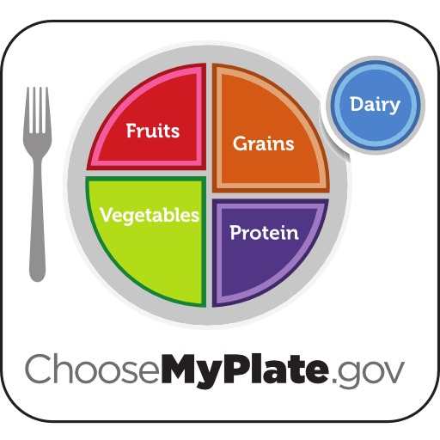
Health Units
Quarter 1 | Quarter 2 | Quarter 3 | Quarter 4
Social & Emotional Health | Safety, First Aid, & Prevention | Disease Prevention | Nutrition and Fitness

Slide 23
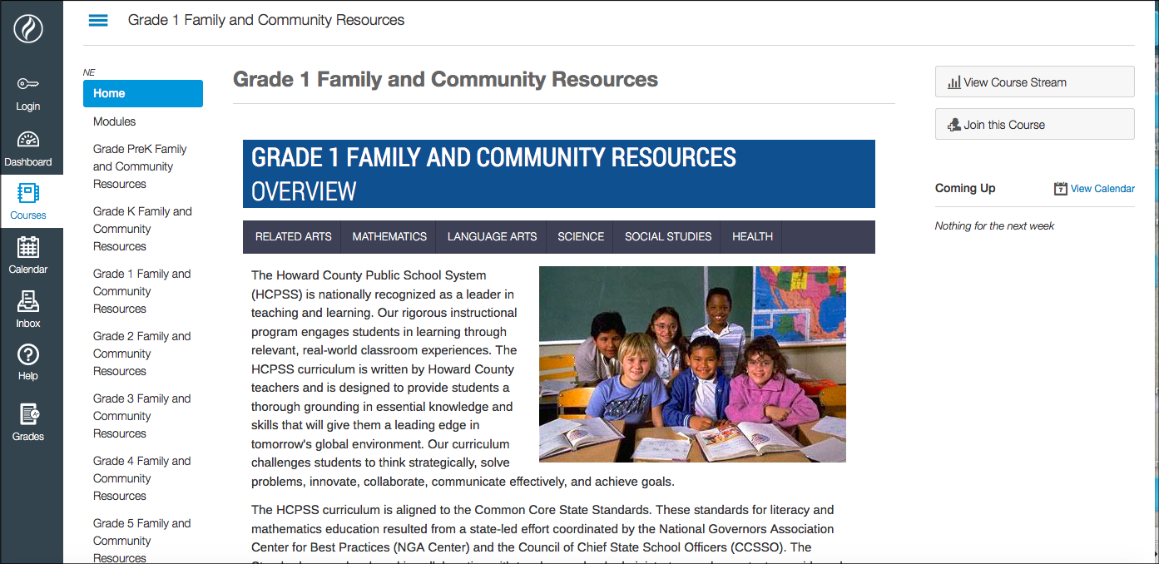
Where Can I Get More Information?
Grade 1 Family and Community Resources Page

Slide 24
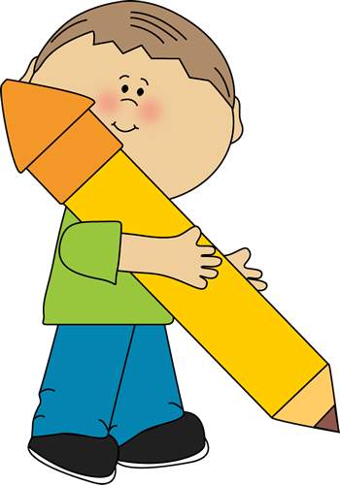
Homework
Reading
Independent or with an adult
15 to 20 minutes
Practicing Sight Words (if sent home)
Math
Basic fact fluency games
Dreambox

Slide 25
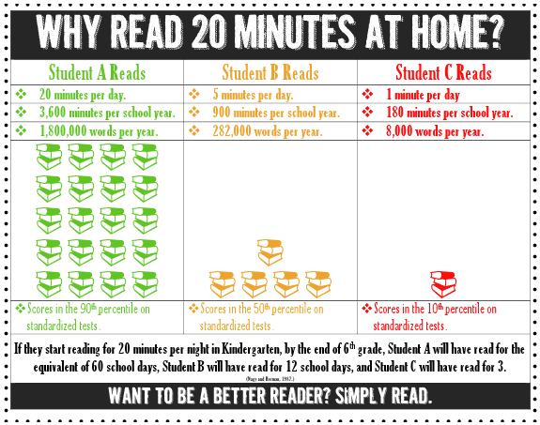

Slide 26
Thursday Folders
Sent every Thursday, return Friday morning
School and community information

Slide 27
Dismissal Procedures
School policy dictates your child will follow his or her normal routine, unless his or her teacher receives written notification of the dismissal change.
If meeting a walker, please meet the teachers under the tree and check in with the teachers before leaving with your child.
Notes:
Please send a written note with your child. Due to the busy nature of our day, we may not see emails or messages on ClassDojo until after dismissal.

Slide 28
Questions?

