Slide 1
BACK TO SCHOOL NIGHT 1ST GRADE
2019-2020

Slide 2
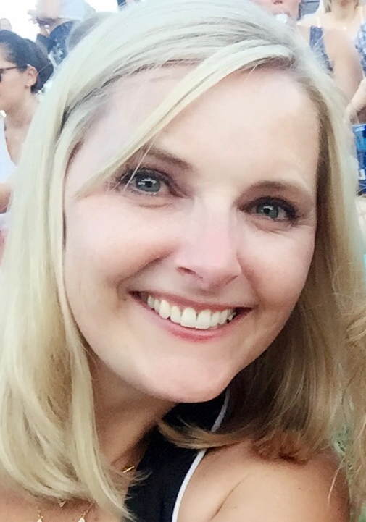
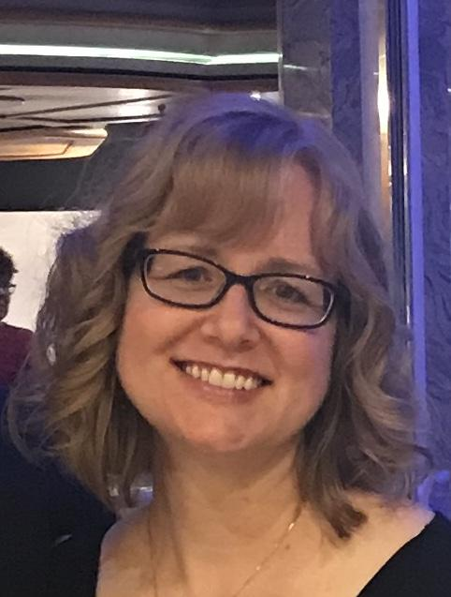
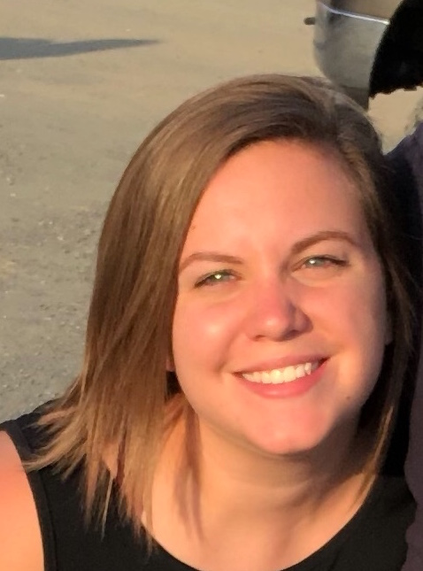
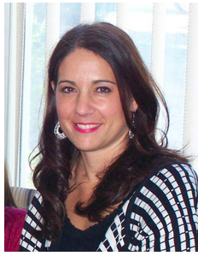
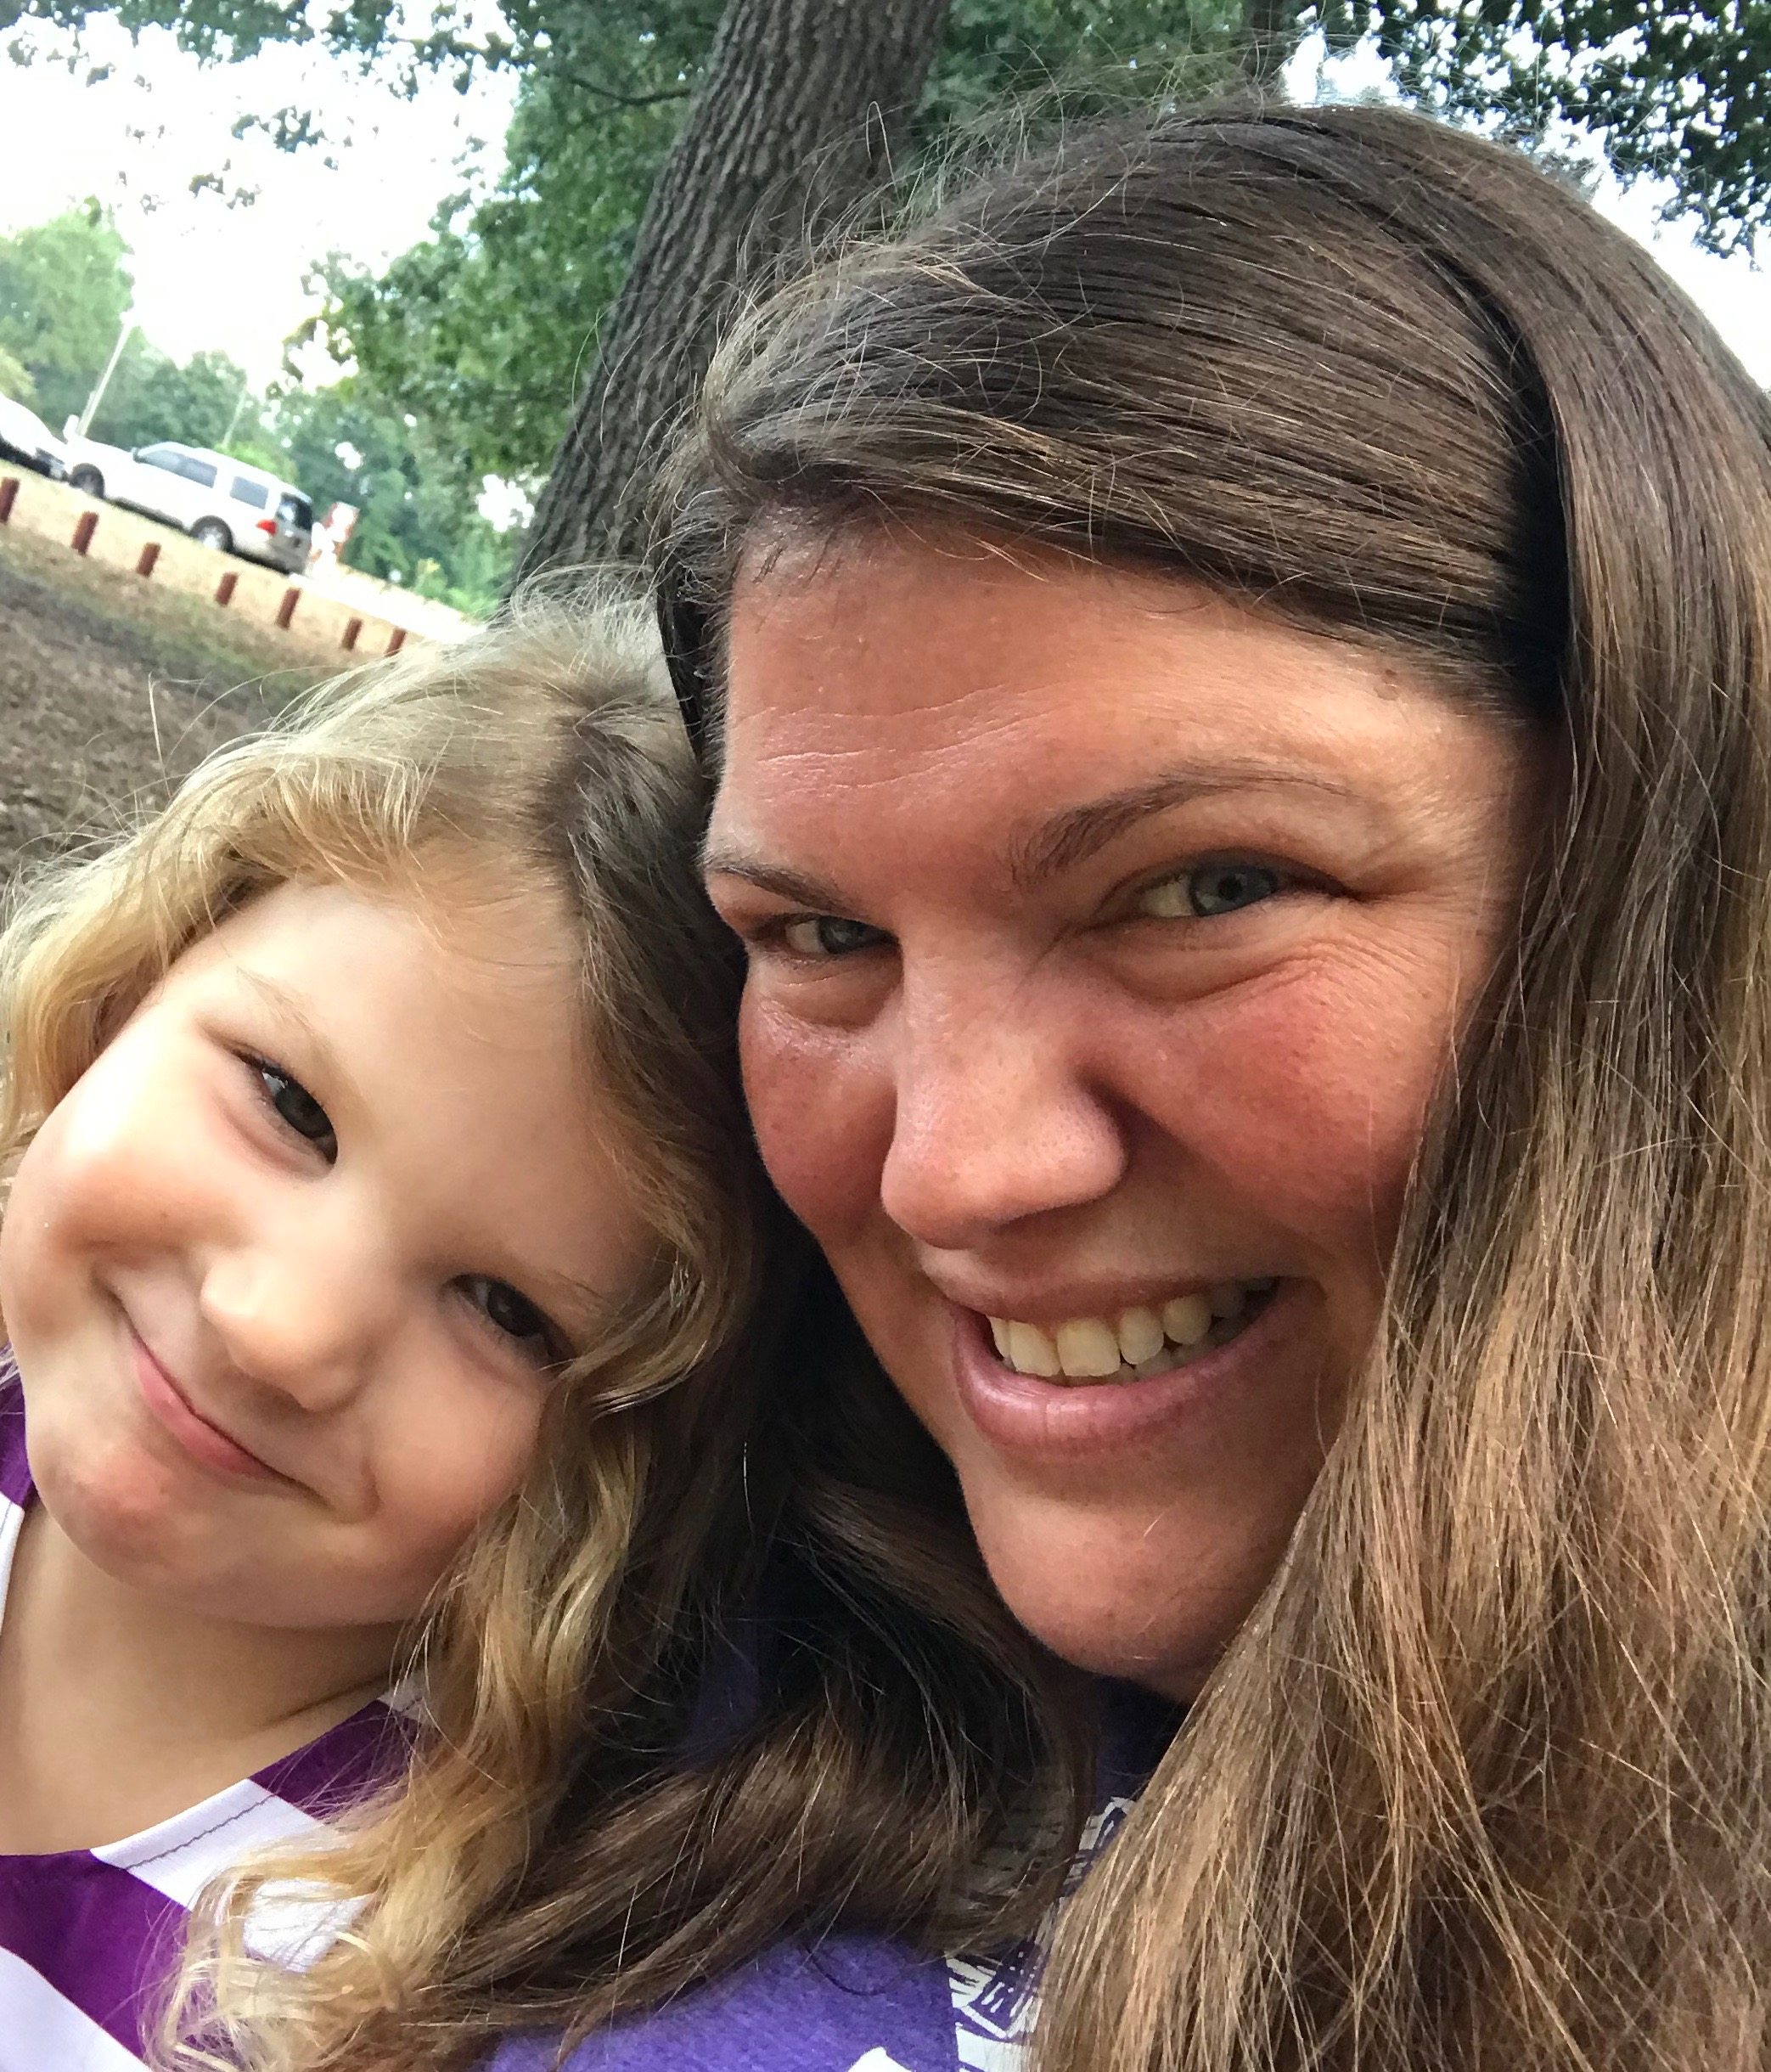
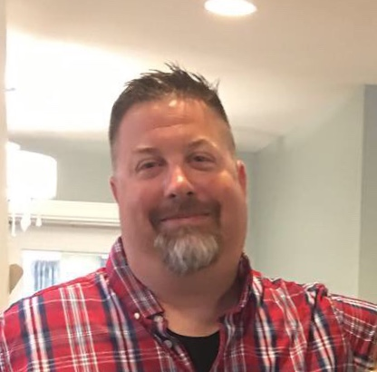
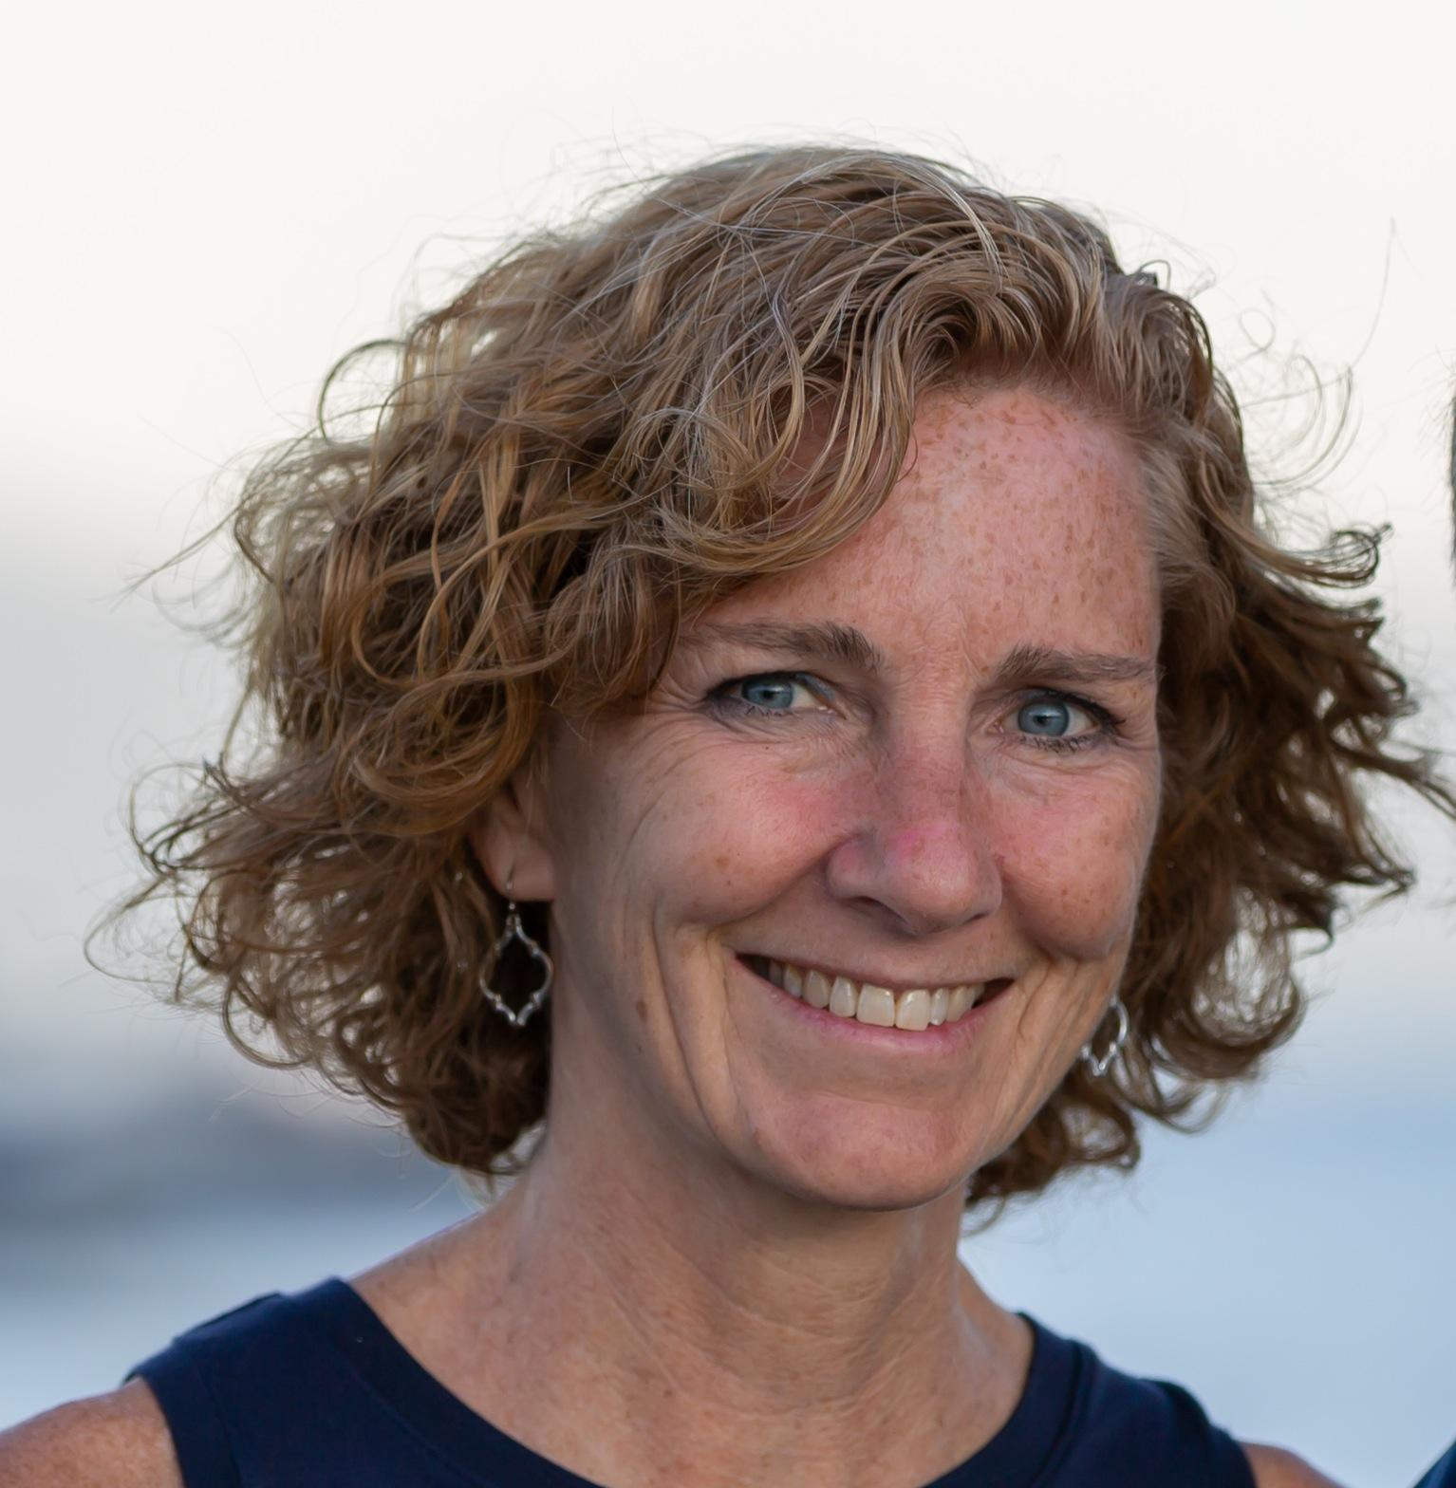
MEET THE TEACHERS!
Mrs. Anderson
Classroom teacher
Mrs. Ashmore
Classroom teacher
Mrs. Bae
Classroom teacher
Mrs. Brogan
Classroom teacher
Ms. Johnson
Classroom Teacher
Mrs. Dorsey
Special Educator
Mr. Clark
Math Teacher
Mrs. Sharkey
Paraeducator

Slide 3
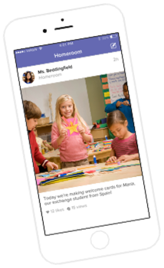
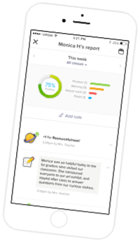
CLASS DOJO
We’ll build a positive culture where students are engaged, encouraged, and love learning!
Families are part of our classroom community, seeing what we are learning.

Slide 4
A TYPICAL FIRST GRADER’S DAY…
Arrival/Breakfast 8:40-9:00
Class Circle 9-9:15
ELA 9:15-11:15
Lunch 11:15-11:45
Recess 11:45-12:15
Math 12:15-1:30
Content (Science, Social Studies, Health) 1:30-2:15
Related Arts 2:15-3:15
Dismissal 3:25

Slide 5
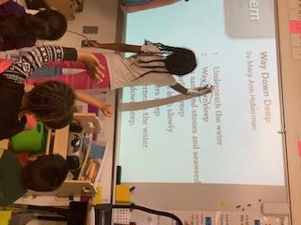
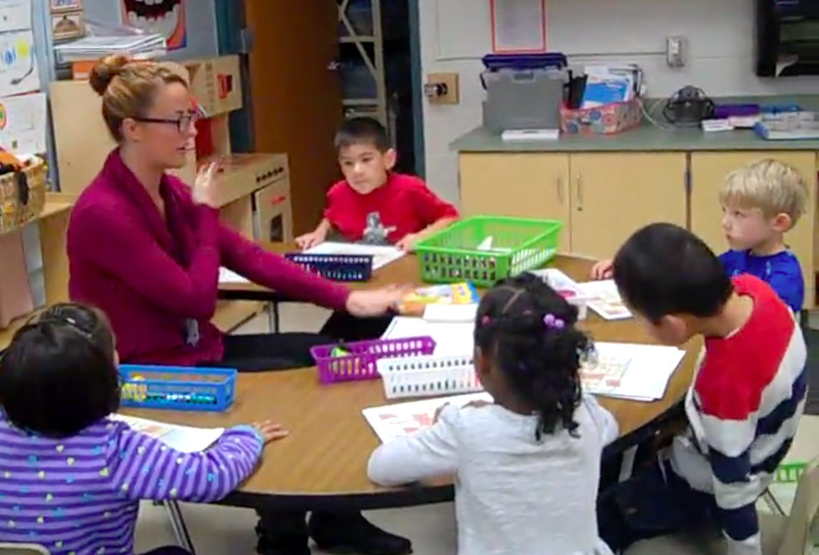
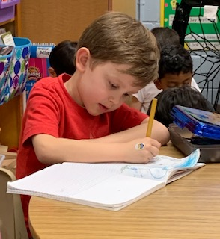
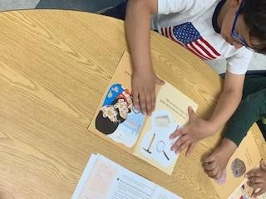
Being A Reader
Whole Class Instruction
Small Group Instruction
Handwriting

Slide 6
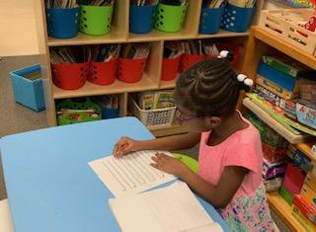
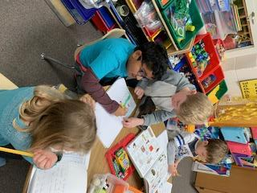
Being A Writer
Students will explore writing using their knowledge of individual sounds to write words, build sentences, and begin to use punctuation
Build Social Skills
Share and Discuss Work
Write Original Pieces

Slide 7
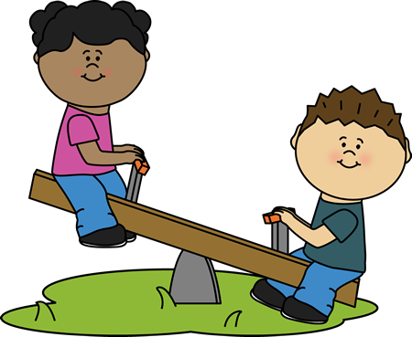
LUNCH & RECESS
Lunch:
PLES cannot lend money for lunch according to the Food Services policy.
Salad bar!
Please help your child learn his or her PIN NUMBER.
Recess:
Dress your child for the weather!
Label your child’s belongings.

Slide 8
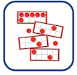
MAJOR MATH CONCEPTS
Number Concepts
Numbers and Operations
Time
Measurement and Data
Geometry

Slide 9
BASIC FACTS
Basic fact flash cards practiced nightly for 10 minutes
+/- 1 and 2
+/- Making ten and +/- 0
+/- Doubles/Halves
+/- 10

Slide 10
DREAMBOX ONLINE LEARNING

Slide 11
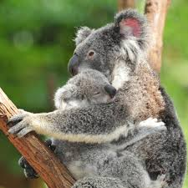
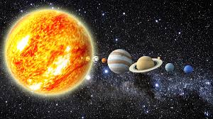
SCIENCE UNITS
Quarter 1 | Quarter 2 | Quarter 3 | Quarter 4
Plant and Animal: Structure and Function | Patterns in Space Systems | Light | Sound

Slide 12
SOCIAL STUDIES UNITS
Quarter 1 | Quarter 2 | Quarter 3 | Quarter 4
Working Together | Our World of Cultures | Communities at Work | Our Changing World

Slide 13
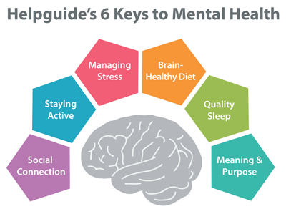
HEALTH UNITS
Quarter 1 | Quarter 2 | Quarter 3 | Quarter 4
Social & Emotional Health | Safety, First Aid, & Prevention | Disease Prevention | Nutrition and Fitness

Slide 14
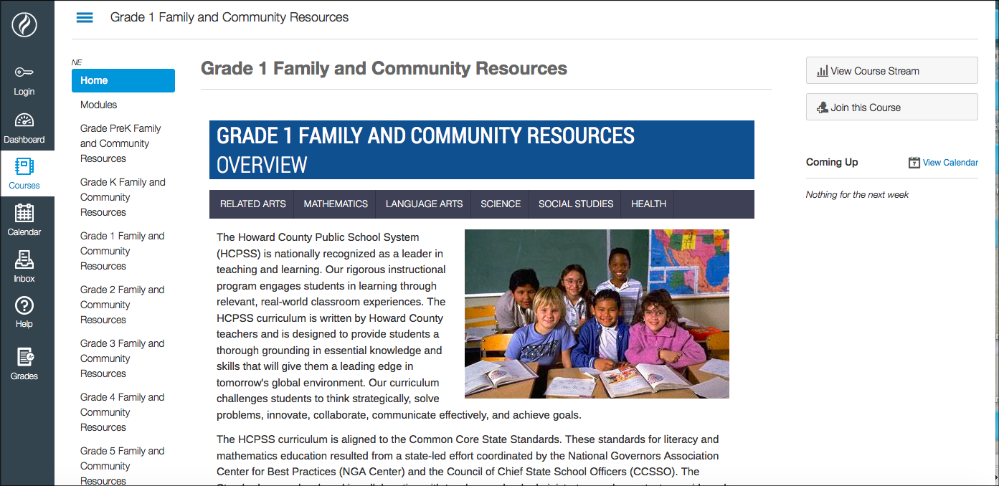
WHERE CAN I GET MORE INFORMATION?
GRADE 1 FAMILY AND COMMUNITY RESOURCES PAGE

Slide 15
GROWTH MINDSET
The brain is a muscle: Challenges make it stronger!
The power of YET! I can’t do that YET.
Mistakes help me to learn more! Let me try another way.
Effort and persistence: I will try my best every day!
Positive attitude: Everyone can learn!

Slide 16
HOMEWORK
Reading
Independent or with an adult
15 to 20 minutes every night
Math
Basic fact practice
Dreambox
Follow-up Practice

Slide 17
DAILY FOLDERS
Folders are sent home every day. Please remove papers and return the next school day.
Folder includes school and community information.
Return homework in the folder by Friday each week.
A volunteer sign up sheet will be coming home shortly
in folders.

Slide 18
DISMISSAL PROCEDURES
School policy dictates your child will follow his or her normal routine, unless his or her teacher receives written notification of the dismissal change.
If meeting a walker, please meet the teachers under the tree with the bench and check in with the teachers before leaving with your child.

Slide 19
Please complete the evaluation form.

