Slide 1
Back to School Night 1st Grade
2016-2017

Slide 2
Agenda
Presentation 1:
Breakfast, lunch, & recess
Dismissal procedures
Communication & Class Dojo
What your child will learn in MATH in 1st grade
Presentation 2:
What your child will learn in READING in 1st grade
Notes:
Wendy

Slide 3
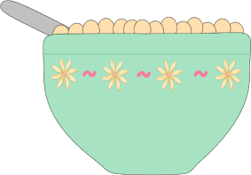
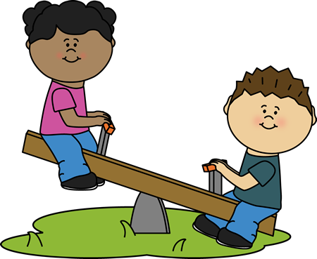
Breakfast, Lunch, Recess
Lunch:
PLES cannot lend money for lunch according to the Food Services policy.
Please help your child learn his or her PIN NUMBER.
Breakfast:
Breakfast is over at 9:00.
Recess:
Dress your child for the weather!
Label your child’s belongings.
Notes:
Wendy
We go outside in temperatures down to 20 degrees with wind chill factor and up to 95 degrees.

Slide 4
Dismissal Procedures
School policy dictates your child will follow his or her normal routine, unless his or her teacher receives written notification of the dismissal change.
Please call the school or send a written note with your child. Due to the busy nature of our day, we may not see emails or messages on ClassDojo until after dismissal.
Notes:
Wendy

Slide 5
Communication
Thursday Folders
Sent every Thursday, return Friday morning
School and community information
1st Grade Folders:
Leave folder in backpack
Grade-specific important information, send notes to teachers
Notes:
Wendy

Slide 6
Class Dojo
We will be using ClassDojo as part of our PBIS program.
We will also be focusing on building important life skills such as working hard and participating.
Notes:
Sarah

Slide 7
Let’s create an amazing
classroom community!
We’ll build a positive culture by encouraging skills like “Helping others” and “Perseverance”.
We want all parents engaged in our classroom, seeing what we’re learning every day!
Notes:
Sarah

Slide 8
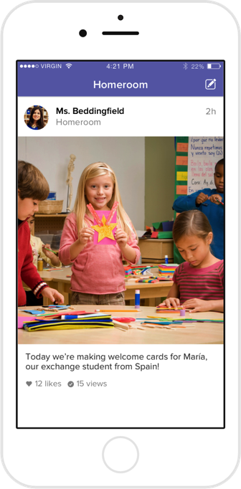
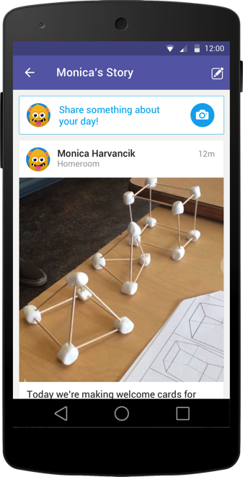
How we’ll use ClassDojo :)
As teachers, we will:
Post important updates and announcements
Share photos and videos of our classroom activities
Share your child’s classwork on his or her own digital portfolio. Only you will be able to view work posted on your child’s portfolio.
Notes:
Sarah

Slide 9
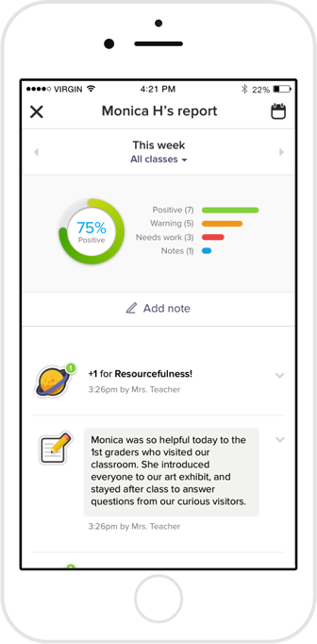
What do parents see?
You’ll see the “Story” of our classroom: photos and videos of big moments, important updates, plus your child’s digital portfolio!
You can also view a “report” of your child’s feedback for skills we are encouraging in class.
Notes:
Sarah

Slide 10
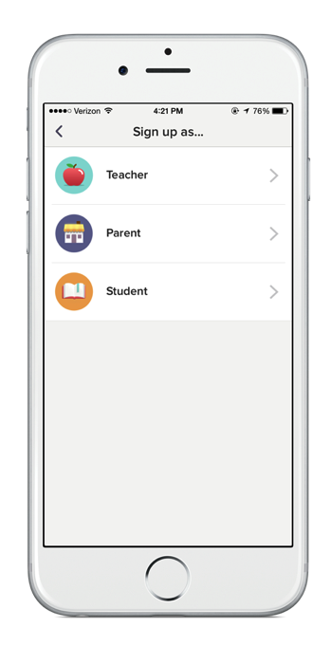
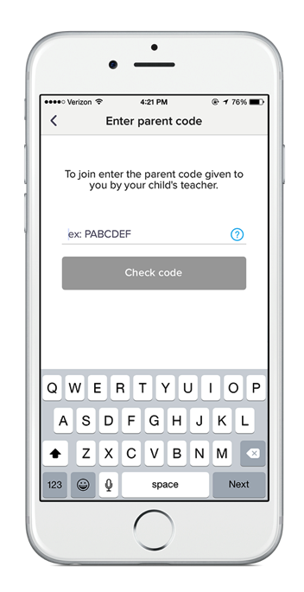
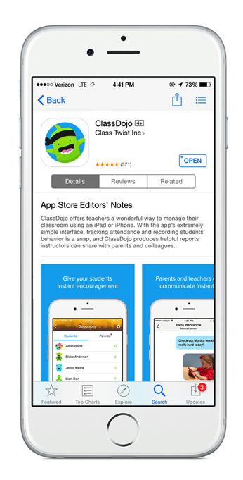
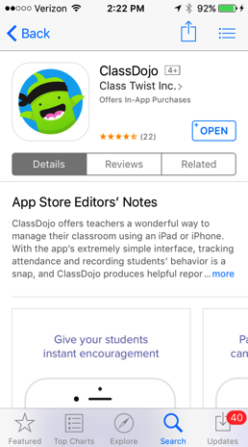
Lets get connected!
1. Download the app.
2. Sign up as a parent.
3. Enter your code!
Notes:
Sarah

Slide 11
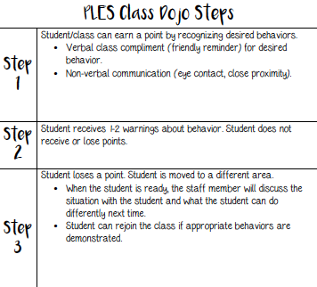
https://home.classdojo.com/#/story?_k=qc6x9s
Notes:
Sarah

Slide 12
1st Grade Math & Science

Slide 13
Major Math Concepts
First Grade:
Number Concepts
Numbers and Operations
Time
Measurement and Data
Geometry
Second Grade:
Number Concepts
Numbers and Operations
Time and Money
Measurement and Data
Geometry
Notes:
Sarah

Slide 14
Basic Facts
Basic Fact Flash Cards Practiced Nightly for 10 minutes
+/- 1 and 2
+/- Making Ten
+/- Doubles
+/- Ten
You will receive notifications quarterly with your child’s scores
Primary Basic Fact Night – Thursday, October 6th
Notes:
Wendy.

Slide 15
A Typical 1st Grade math day
75-90 minutes daily
Begins with a high-quality number routine
Standards based instruction: high quality tasks, variety of representations, purposeful questions, and student discourse
Differentiated instruction
Math Journal
Additional staff: Mr. Clark, Mrs. O’Neill, Dr. Stevens
Notes:
Sarah

Slide 16
homework
Homework will come home on Monday and is due Friday
Basic Fact Fluency Games and Cards
Purpose of Homework:
Parent/Child Academic Relations
Practice
Notes:
Wendy

Slide 17
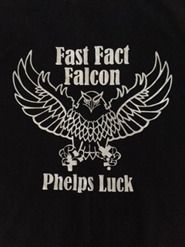
Fast fact falcon program
With your child’s hard work and home practice, he/she will earn a Fast Fact Falcon T-shirt after passing first grade facts!
Notes:
Wendy

Slide 18
Dreambox online learning
DreamBox Learning is an online, adaptive learning program used at PLES.
Research shows it improves math skills for students at their individual levels.
Badges, coins, and unlockable mini-games are integrated into the program to reward and engage students.
This program can also be played at home. Look for DreamBox information in your child’s homework envelope.
Notes:
Sarah

Slide 19
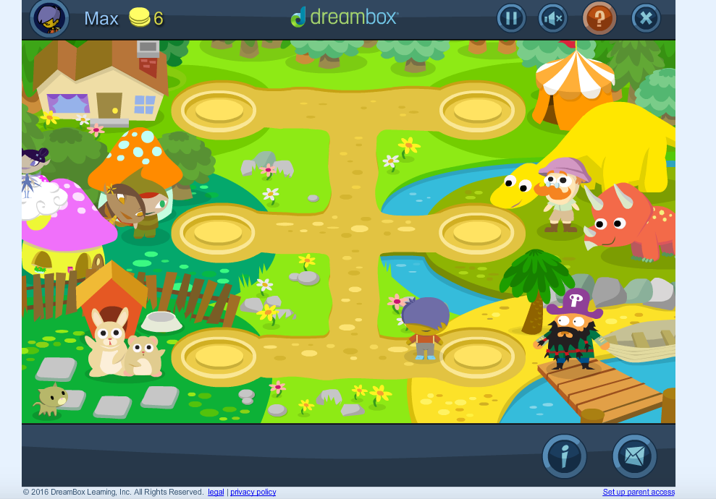
Dreambox online learning
Notes:
Sarah

Slide 20
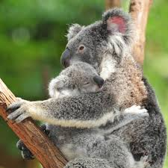
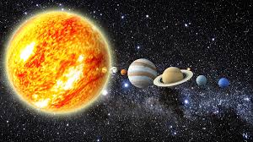
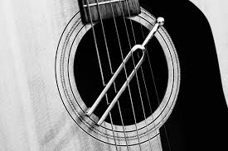
1st Grade science units
Quarter 1:
Plant and Animal: Structure and Function
Quarter 2:
Patterns in Space Systems
Quarter 3:
Light
Quarter 4:
Sound
Notes:
Q1: Adult plants and animals can have young. In many kinds of animals, parents and their offspring engage in behaviors that help the offspring survive.
Animals have body parts that capture and convey different kinds of information needed for growth and survival. Animals’ behavior in reaction to this information can help them survive.
Young animals are very much, but not exactly, like their parents. Plants also are very much, but not exactly, like their parents.
Q2: The sun, moon, and stars move in a predictable pattern that can be observed, described clearly, and predicted ahead of time.
Patterns (such as sunrise, sunset, seasons, and stars) can all be observed, described, and predicted ahead of time.
Q3: Objects can be seen if light is available to shine on them. Objects can also be seen if they give off their own light.
Some materials allow light to pass through them (transparent), some materials allow only some light to pass through (translucent), and others block all the light and do not allow light to pass through (opaque).
Light can be used to communicate over long distances.
Q4: Sound can make materials vibrate.
Vibrating material can make sound.
People have created and used a variety of devices to make sounds that communicate over long distances.

Slide 21
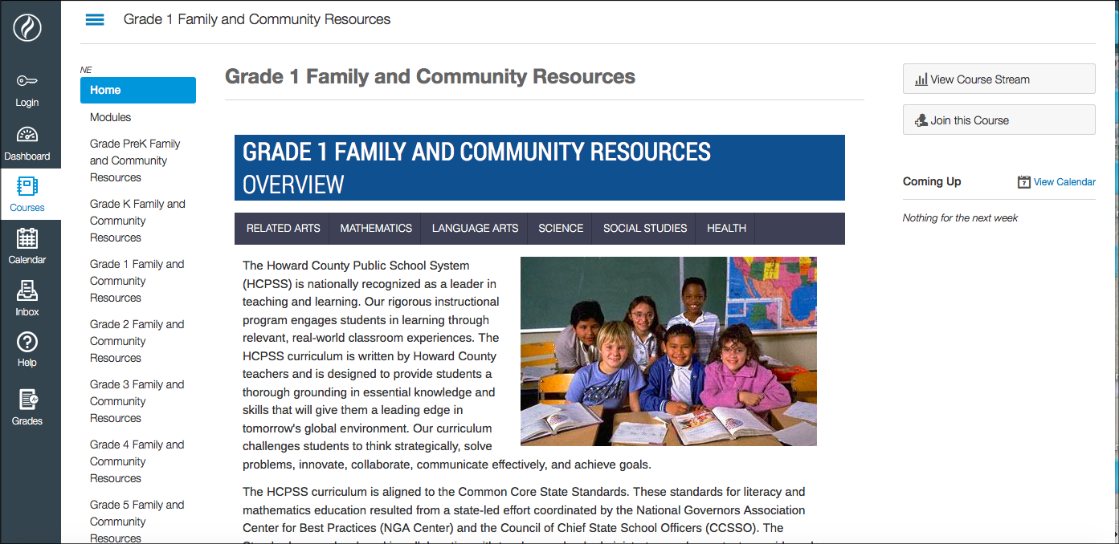
Where can you get more information?
Grade 1 Family and Community Resources Page
Notes:
Sarah

Slide 22
Questions?

